Slide 1
IX- ECONOMICS. CHAPTER -1 THE STORY OF VILLAGE PALAMPUR
BY Mr. K.C. PANDA (T.G.T.- S.Sc)
D.A.V. PUBLIC SCHOOL BERHAMPUR

Slide 2
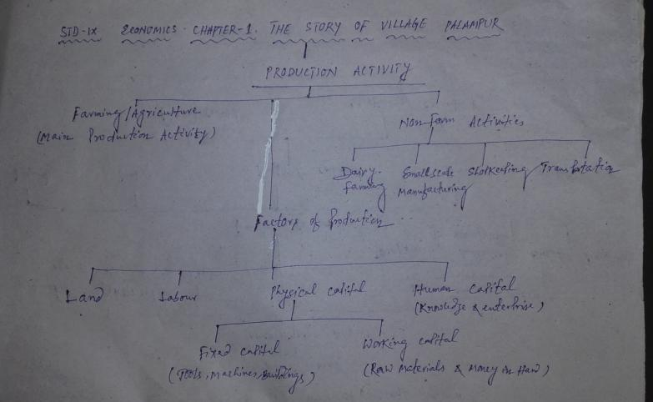
THE STORY OF VILLAGE PALAMPUR CONCEPT MAP

Slide 3
THE STORY OF VILLAGE PALAMPUR BASIC PURPOSE OF THE CHAPTER
To introduce the basic concepts relating to production through a story of a hypothetical village called Palampur.
Like any other Indian village main production activity – Agriculture/Farming
Other activities –Non farm activities : Small-scale manufacturing, Dairy, transportation, shop keeeping etc.

Slide 4
Facilities available in Palampur
Well connected roads with nearby village and town(Raigang & Shahpur respectively)
Availability of Transport system like bullock carts, tongas, bogeys ,motorcycles, jeeps, tractors and trucks.
Availability of electricity, irrigation(electric run tube wells) schools(two primary schools and one high school) & health centres(one primary health centre & one private dispensary)

Slide 5
Organisation of Production- Factors
Main aim of Production – To produce the goods and services that we want.
Factors responsible:
Land (It includes other Natural resources such water, forests, minerals)
Labour: People who will do the work

Slide 6
Organisation of Production- Factors
Physical Capital – The variety of inputs required at every stage during production
i)Fixed Capital –Tools, machines, buildings etc.
ii) Working Capital : Raw materials and money in hand.
Human Capital : Knowledge and enterprise to use land, labour, physical capital to maximise production.

Slide 7
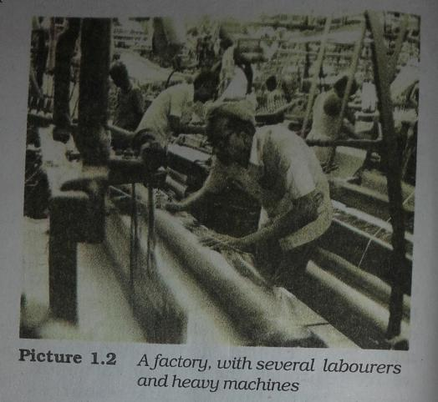
Activity- In the given picture Identify the land, labour & fixed capital used in production

Slide 8
Farming in Palampur – Some facts
Land- Fixed.
Total families – 450. ( Upper caste owns majority of lands, 150 dalits having no land, 240 families have small plots less than 2 hectares (standard unit of measuring land)

Slide 9
Ways to grow more than one crop from the same piece of land in a year
Multiple cropping- Growing of three different crops in a year in Palampur due to the well-developed system of irrigation
Rainy season (kharif) – Farmers grow jower & bajra,
Oct. & Dec. potato
Winter season(rabi)-Wheat
Apart from all these farmers in Palampur also grow sugar cane once in a year.

Slide 10
Ways to grow more than one crop from the same piece of land in a year
Use of Modern farming methods: Use of better fertilizers, pesticides, manures, high-yielding variety of seeds, modern farm machineries like tractors, thrashers, harvesters, better irrigation and many more.
All these inputs gave birth to Green Revolution in India.

Slide 11
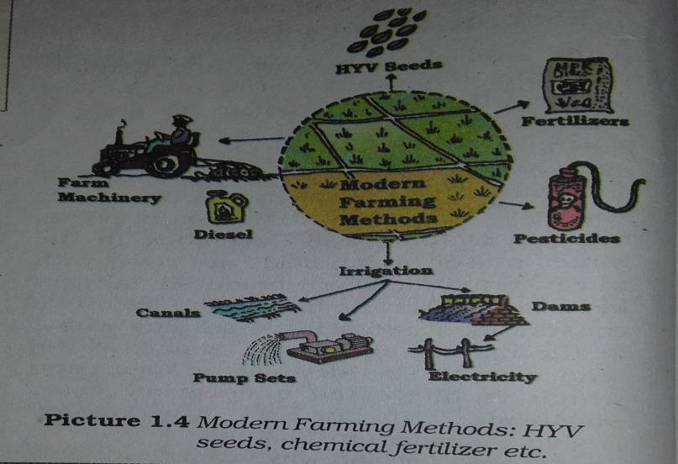
Modern Farming methods

Slide 12
Green Revolution
Father- M.S. Swaminathan in India (Norman Borlaug of USA in the World)
It led to spectacular increase in the production of food grains namely wheat and rice using Modern Farming Methods.
States benefitted- Punjab, Haryana,& Western Utter Pradesh

Slide 13
Demerits of Green Revolution
Increased use of Chemical fertilizers- loss of soil fertility, pollutes ground water, kills useful bacteria of the soil
Continuous use of ground water for tube-well irrigation - Reduction of the water table below the ground.

Slide 14
HOME WORK - DAY 1
Q.1. Name the factors of production?
Q.2. Define Physical Capital?
Q.3. ‘Human Capital is essential for production of goods and services’. Give one reason?
Q.4. Define Multiple Cropping ?
Q.5. What do you mean by Modern Farming Method ?
Q.6. Define Yield ?

Slide 15
HOME WORK - DAY 2
Q.7. Name the Non-farm activities carried out in the village Palampur ?
Q.8. What is Fixed Capital ?
Q.9. Define Working Capital?
Q.10. Why are the wages for farm labourers in Palampur less than the minimum wages ?
Q.11. What is the standard unit to measure cultivable land ?
Q.12. Define Green Revolution ?
Q.13. Which is a scarce factor of production ?

Slide 16
Labourers in Palampur
Labourers in Palampur either from land-less families or families cultivating small plots of land.
Works on daily wages
Poor
Reasons
Heavy competition for work
So, agree to work for lower wages.

Slide 17
Capital needed for faming in Palampur
Most small farmers- Borrow from large farmers, village money lenders or traders
Medium & Large farmers – from their own savings from farming.

Slide 18
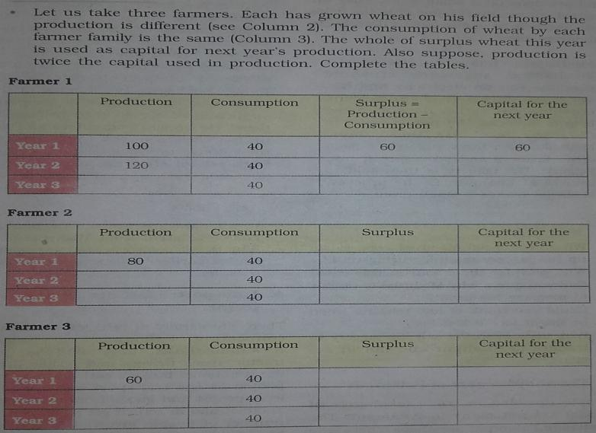
ACTIVITY

Slide 19
Non-Farm Activities in Palampur
Dairy
Small-scale manufacturing carried mostly at home or in the fields with the help of family labour
The Shopkeepers of Palampur
Transportation

Slide 20
HOME WORK - DAY 3
Q.1. Which is the abundant factor of production ?
Q.2. How do small farmers obtain their capital for farming in Palampur ?
Q.3. How do medium and large farmers obtain their capital for farming in Palampur ?
Q.4. State one benefit of electricity for the people of Palampur ?
Q.5. How many families do live in the villagePalampur ?
Q.6. ‘Palampur resembles a modern village’ Give one evidence ?

Slide 21
HOME WORK - DAY 4
‘The distribution of land in Palampur is unequal’ Justify. (3)
‘Modern Farming Methods require more inputs which are manufactured in industry’. Give your comment. (3)
How do the farmers arrange their capital in Palampur?(3)
What are the different ways of increasing production on the same piece of land ? Use examples to explain. (3)

Slide 22
HOME WORK - DAY 5
Distinguish between Multiple Cropping and Modern Farming Methods. (5)
Write the merits and demerits of Green Revolution. (5)
What are Non-farm activities? Give any four examples. Suggest any three measures so that more non-farm activities can be started in villages.(5)

