Slide 1
CLASS 7
SOCIAL SCIENCE (HISTORY)
LN 9. MEDIEVAL PERIOD
PRESENTED BY
N.RAJESWARI
DAV PUBLIC SCHOOL, BERHAMPUR.

Slide 2
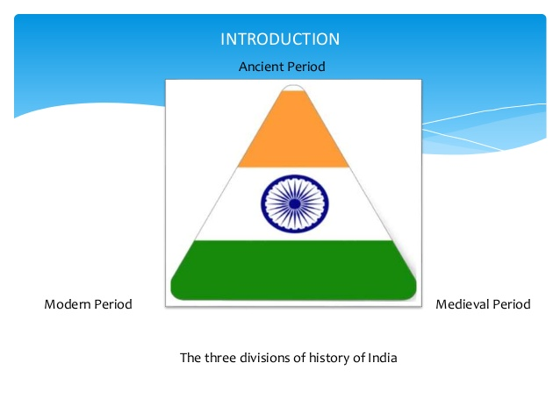

Slide 3
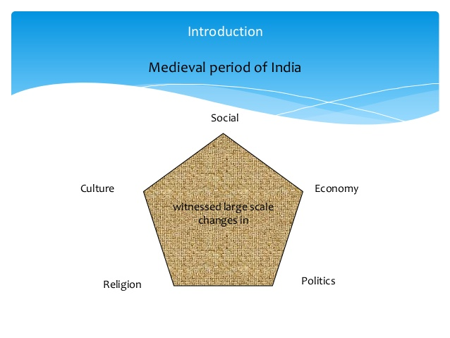

Slide 4
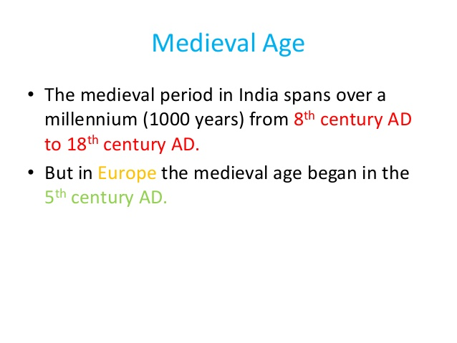

Slide 5
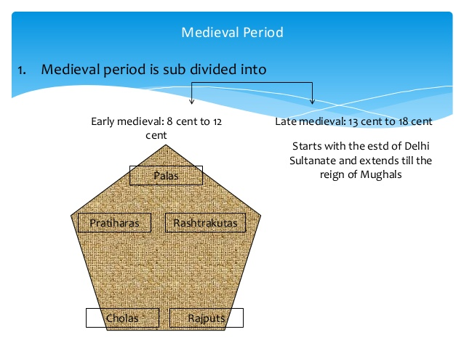

Slide 6
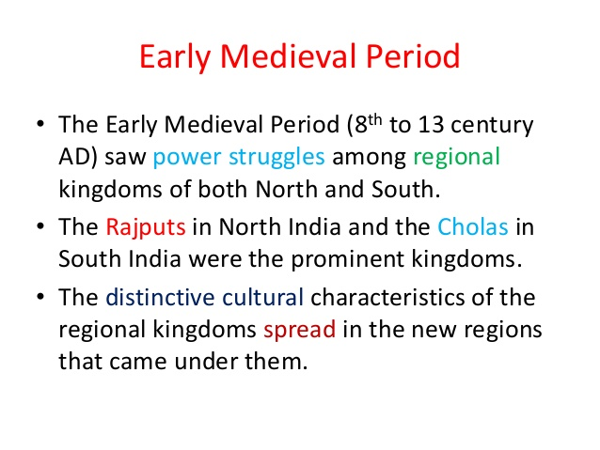

Slide 7
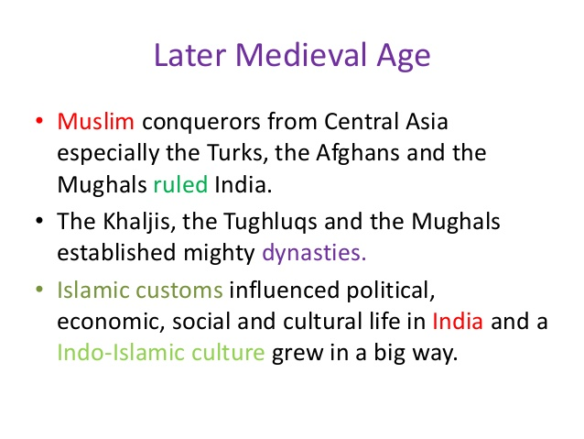

Slide 8
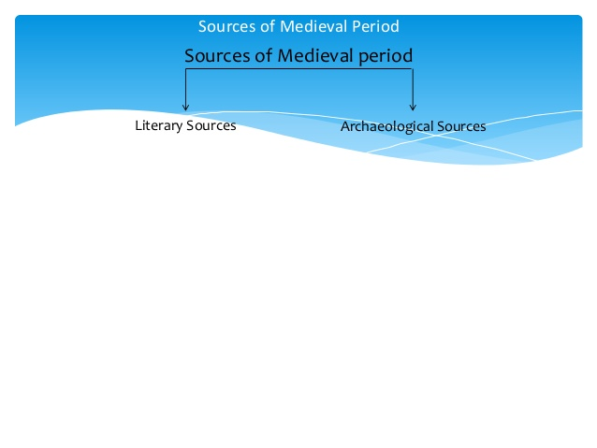

Slide 9
Literature consist of RELIGIOUS & NON-RELIGIOUS.
From religious works & commentaries- Puranas, Smrities etc, we get information about the social, economic, political& military conditions of medieval period.
From non-Religious works on medicine, astronomy, dramas, stories etc.
The autobiographies, orders of the rulers & letters written during this period also helps us to understand the life of the people. For ex- PRITHVIRAJ RASO written by CHAND BARDAI.

Slide 10
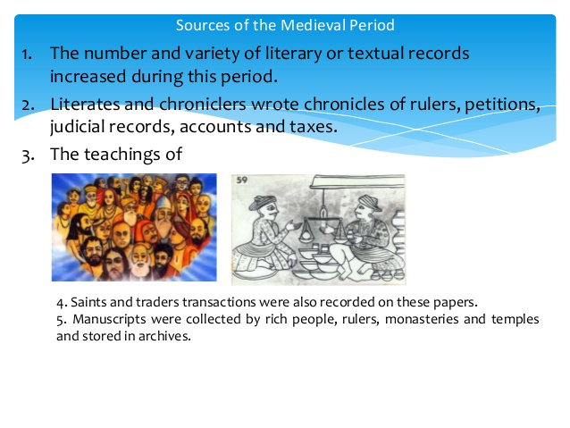

Slide 11
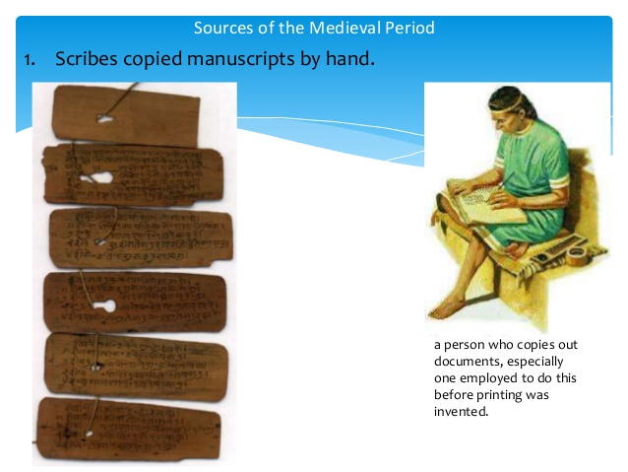

Slide 12
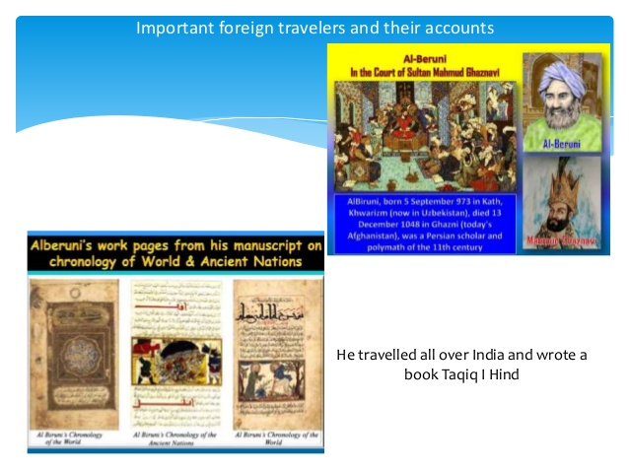

Slide 13
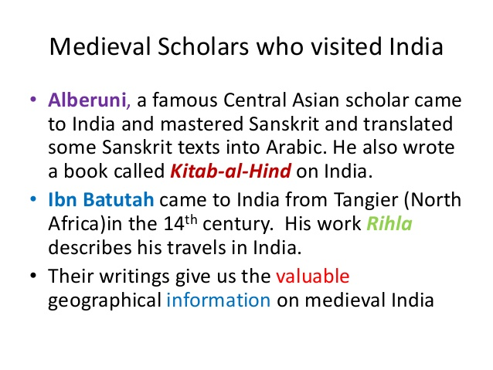

Slide 14
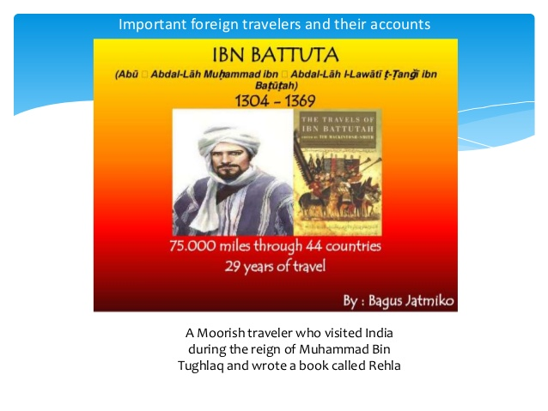

Slide 15
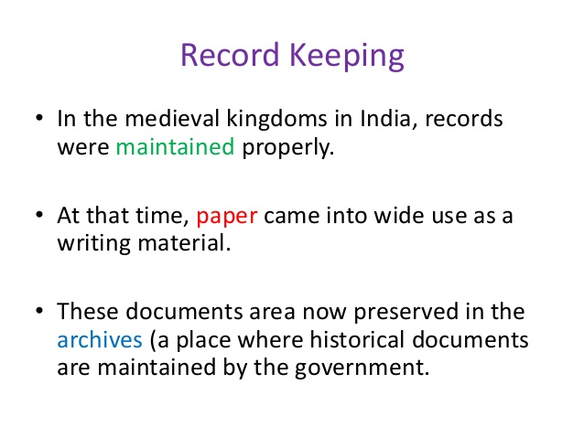

Slide 16
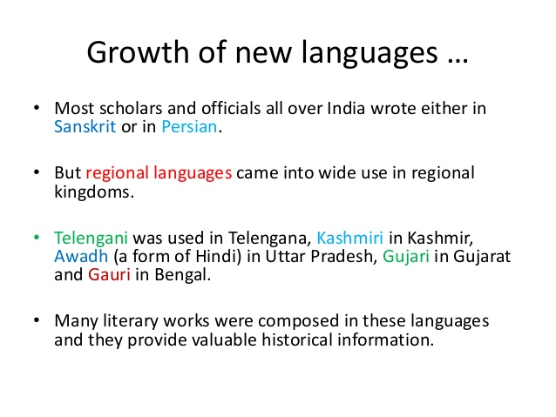

Slide 17
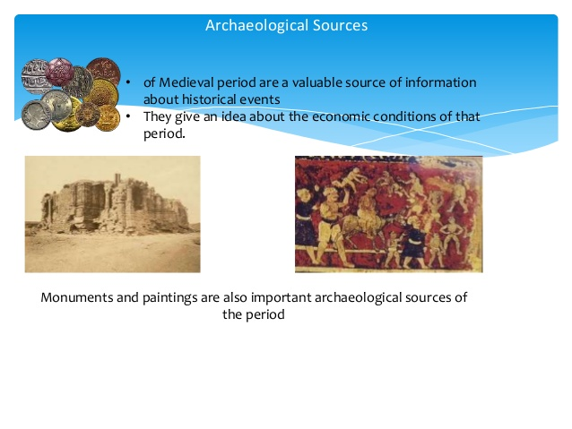

Slide 18
Excavation of medieval towns, sarais, villages, monuments, sculptures, coins, inscriptions etc. give us a lot of information about different aspects of the society.

Slide 19
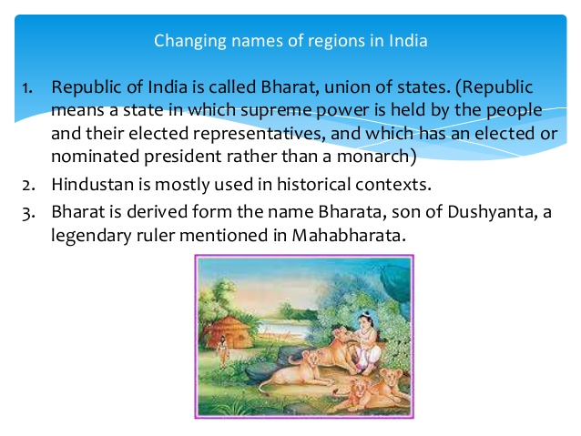

Slide 20
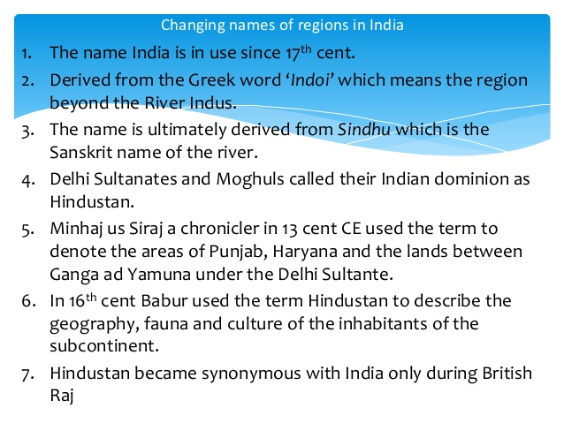

Slide 21
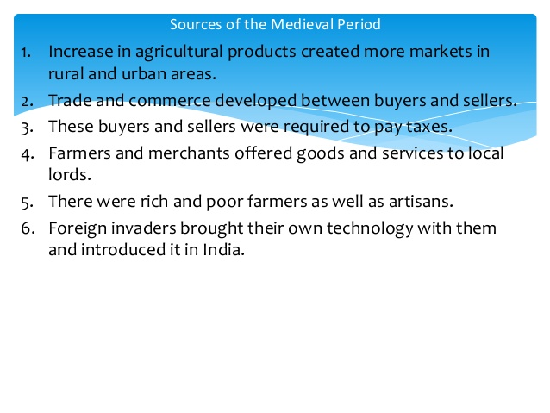

Slide 22
Some of the important technological development of this period are as follows;
1. The Persian wheel was used for irrigation.
2. The spinning wheel made the weaving of clothes easier.
3. Fire arms introduced in combats.
4. Paper was introduced for writing.

Slide 23
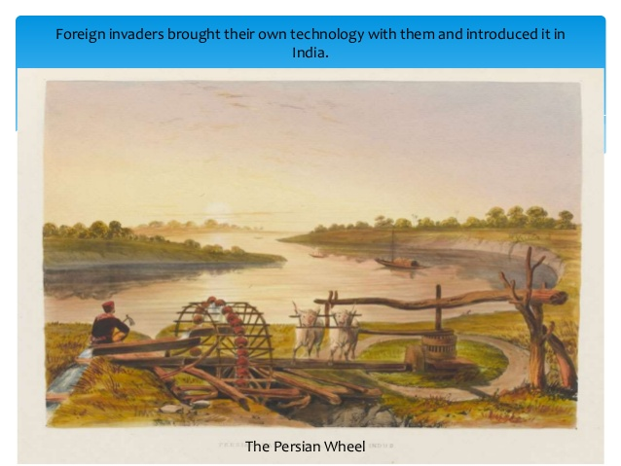

Slide 24
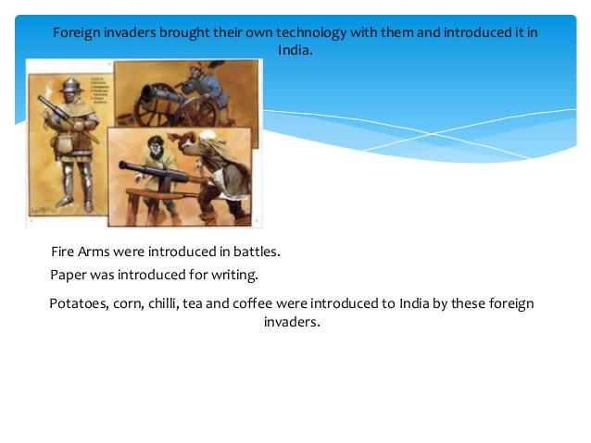

Slide 25
Learn the following questions & answers
What sources do the historians use for the study of a particular period of history?
Ans. The historians use the sources like coins,inscriptions, architectures & textual records for the study of specific period.
2. What do you mean by archives?
Ans. Archives were the places where manuscripts, records, documents collected.
3. Who were scribes?
Ans. Scribes were those professionals who used to copy down the manuscripts.

Slide 26
4. Why are coins& inscriptions important for the study of medieval period?
Ans. Coins & inscriptions tell us about the reigning periods of kings and give us dates of important political events. It tell us about the economy of the kingdom & trade with other regions.
5. What development took place in technology ?
Ans. 1. The Persian wheel was used for irrigation.
2. The spinning wheel made the weaving of clothes easier.
3. Fire arms were introduced in combats.
4. Paper was introduced for writing.

Slide 27
Answer the following questions.
Who wrote Prithiviraj Raso?
Name the language in which Ain-i-Akbari was written.
Which period is known as the medieval period in Indian history?
4. Name the foreign visitors who wrote travel accounts of medieval period.

Slide 28
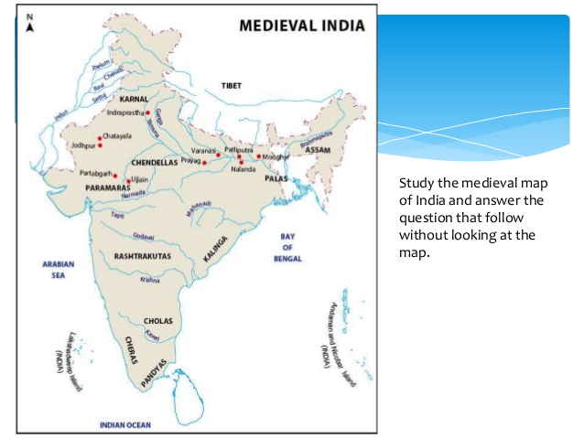

Slide 29
QUESTIONS
Name any five rivers on the map.
Name the kingdoms who ruled India during the medieval period.
How many kingdoms are located on the banks of the rivers?

