Slide 1
SANSKRIT
CLASS-7TH
Note
Grammer is to be written only in Grammer copy

Slide 2
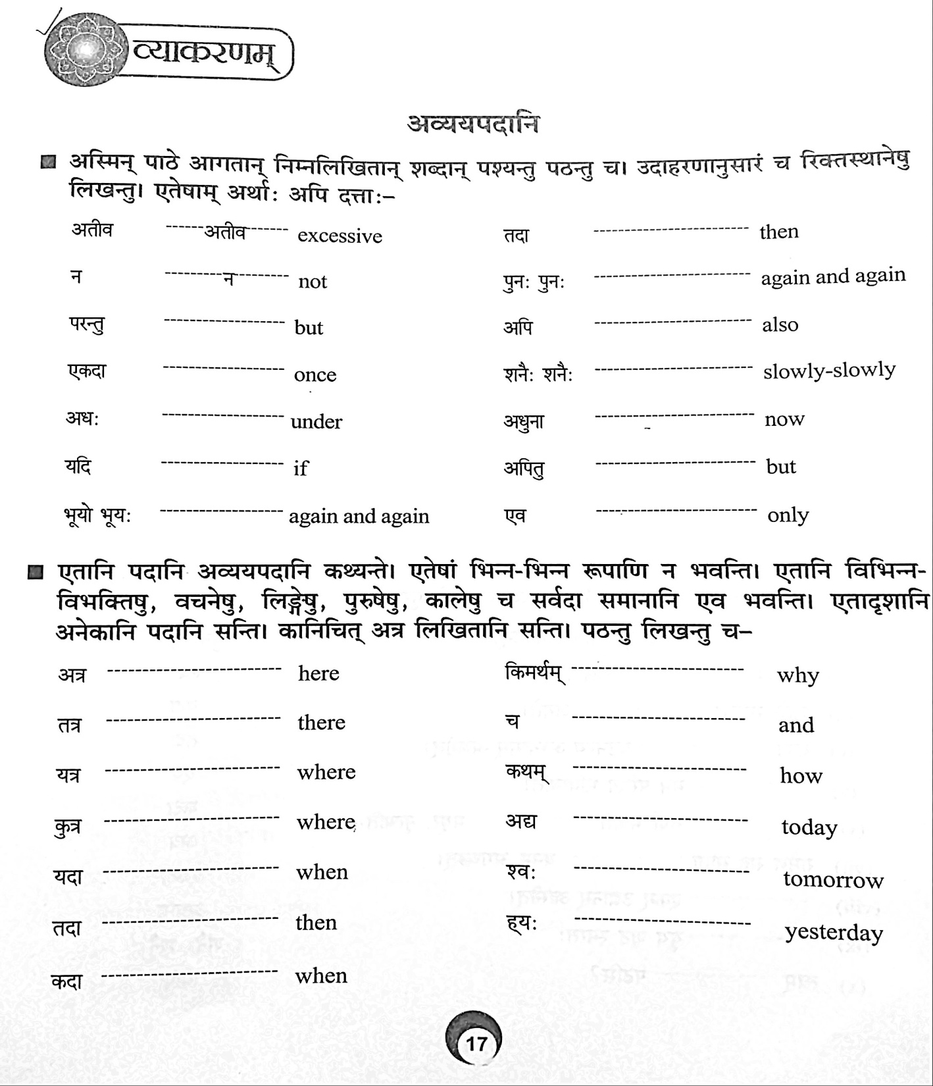

Slide 3
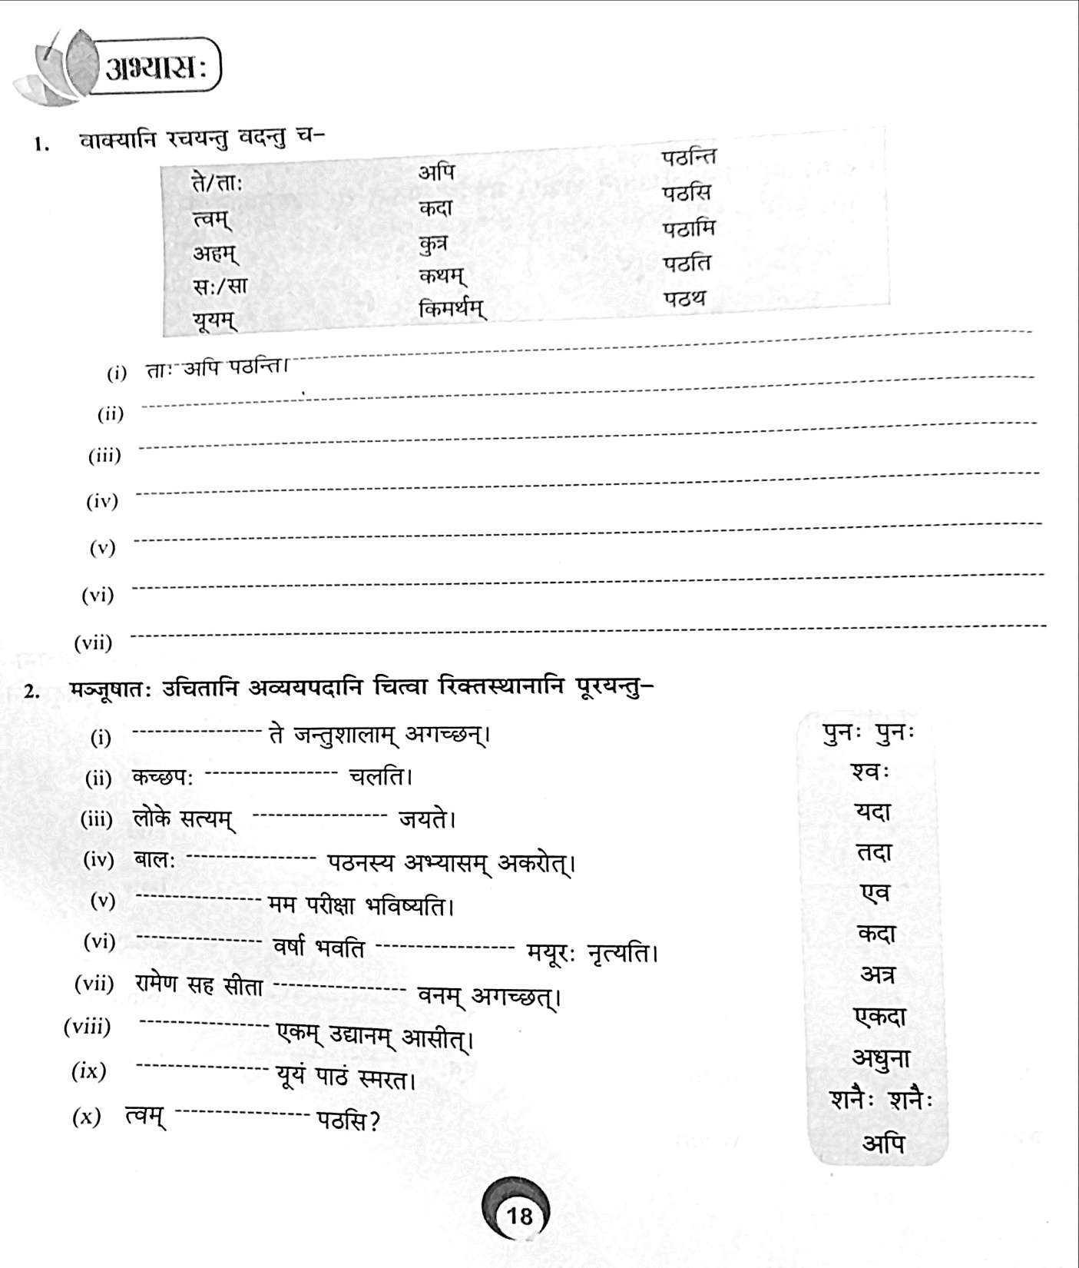

Slide 4
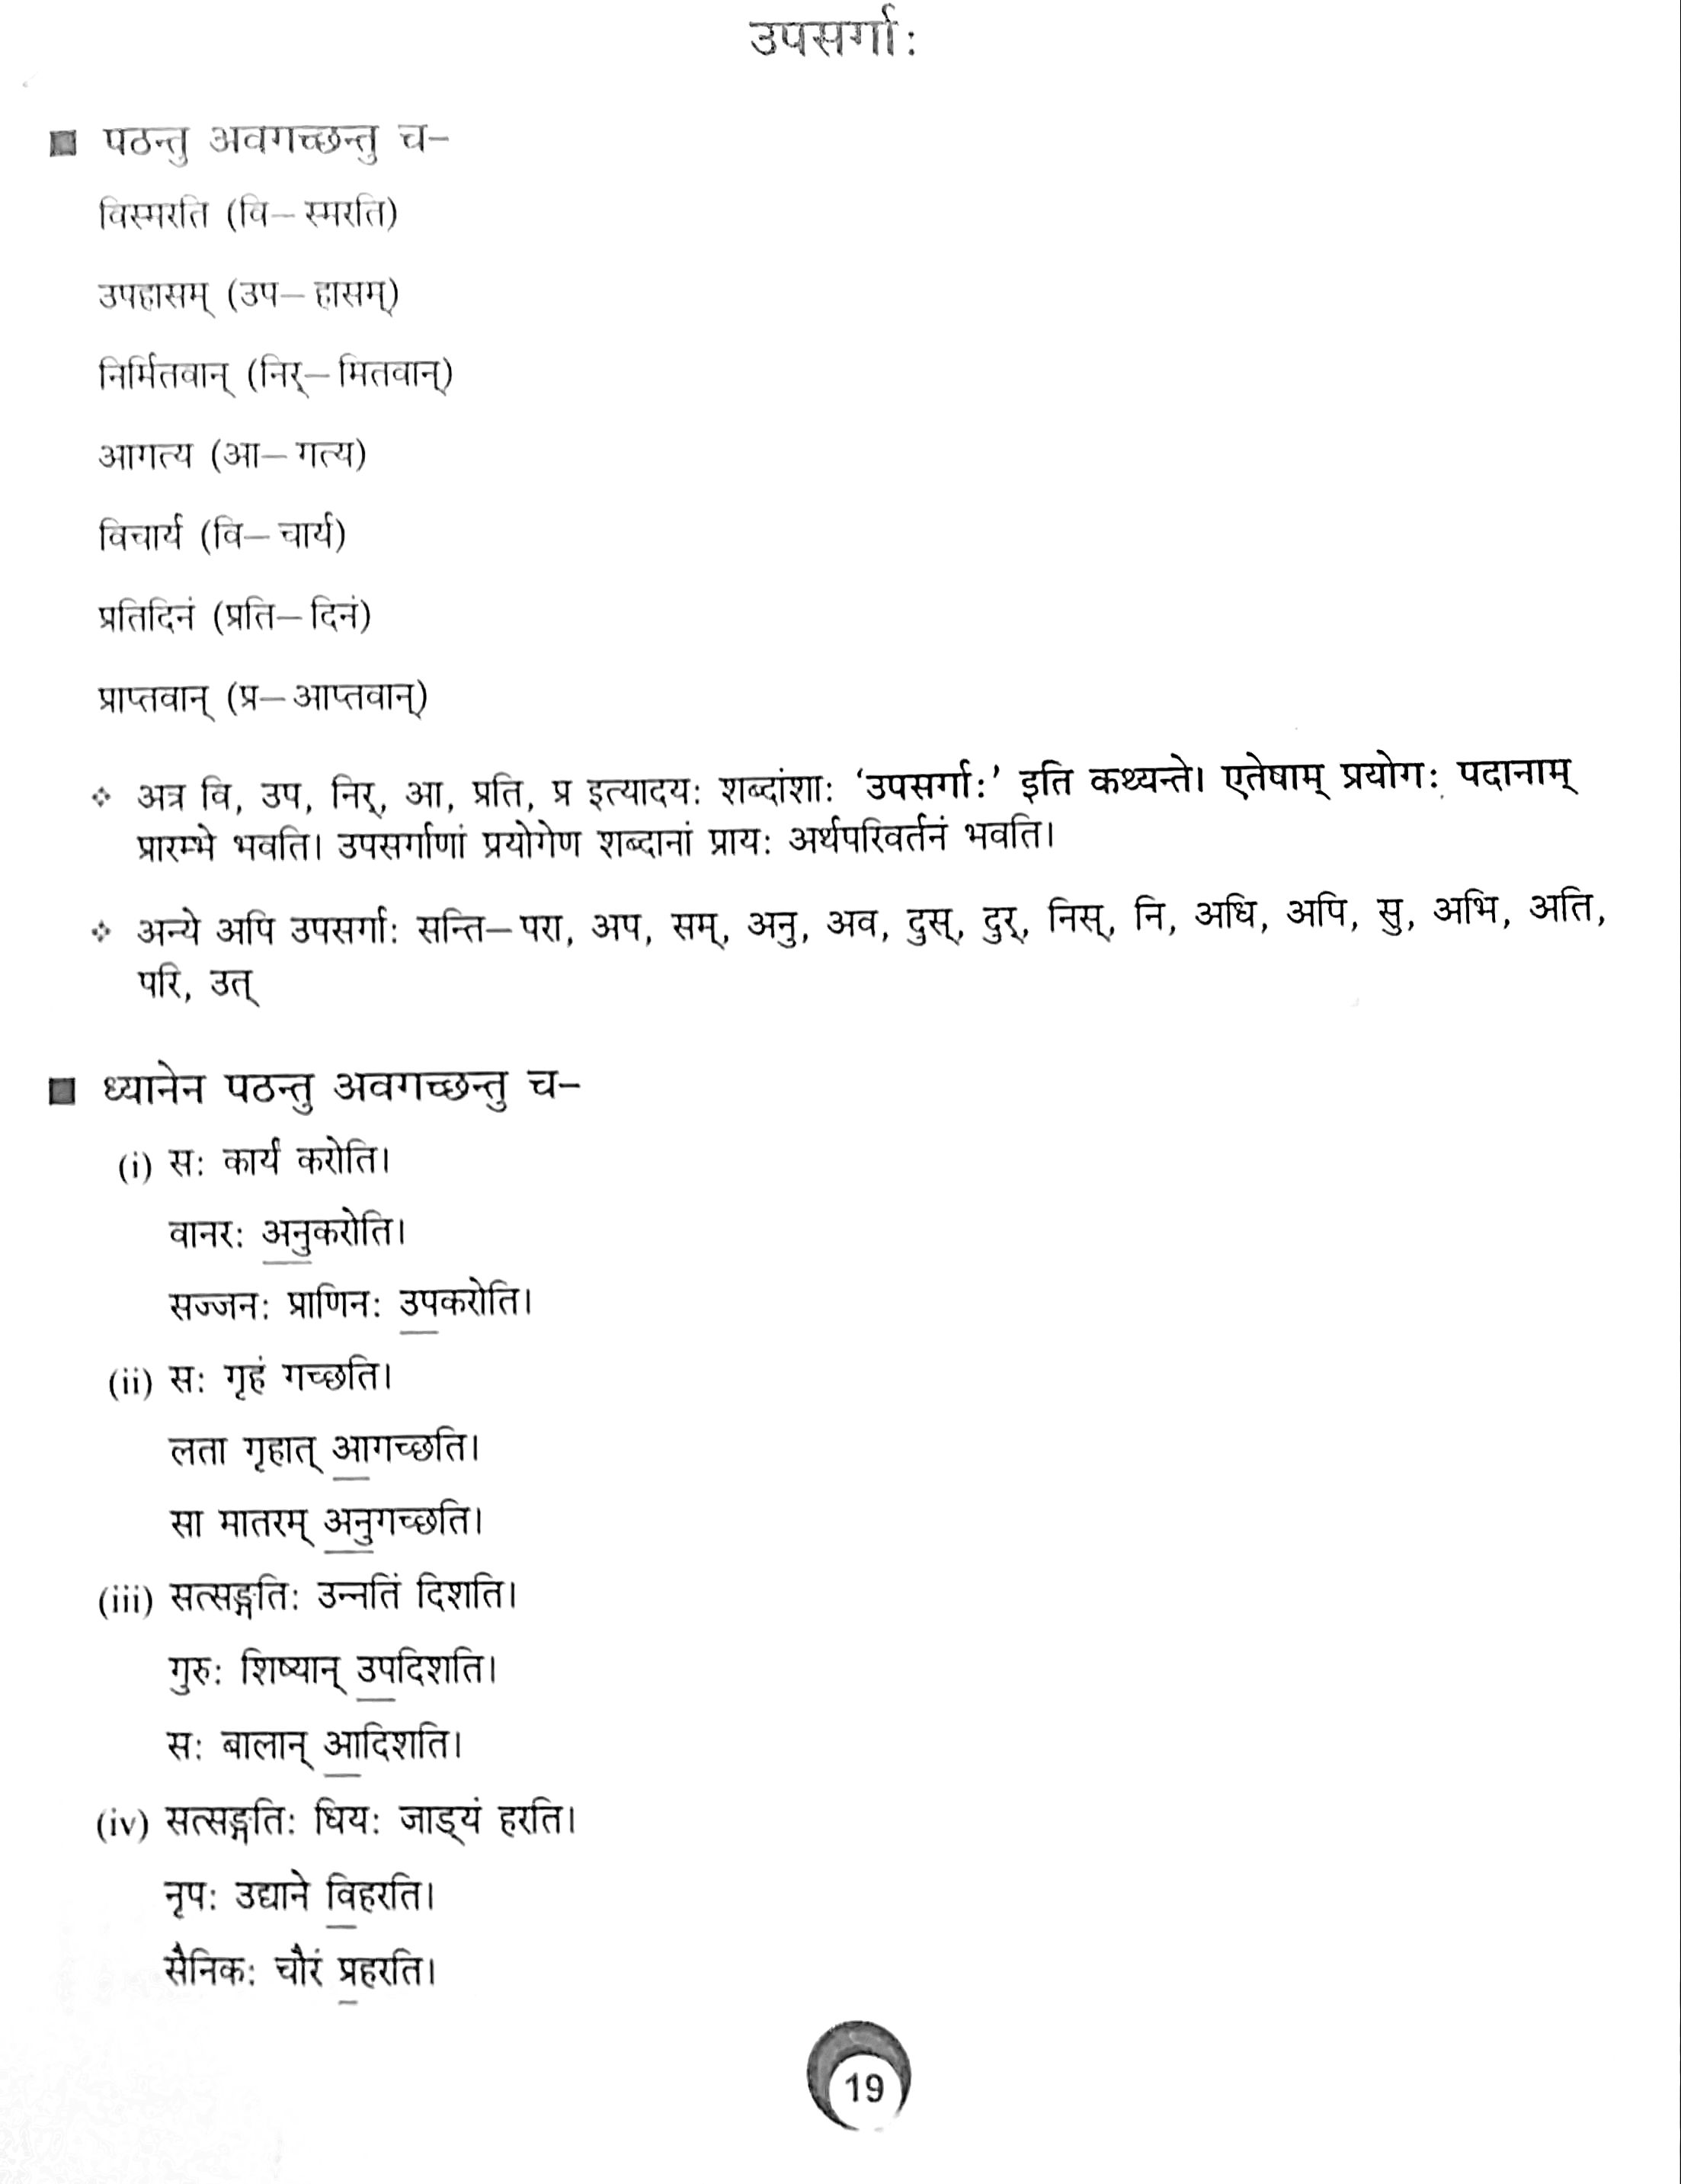

Slide 5
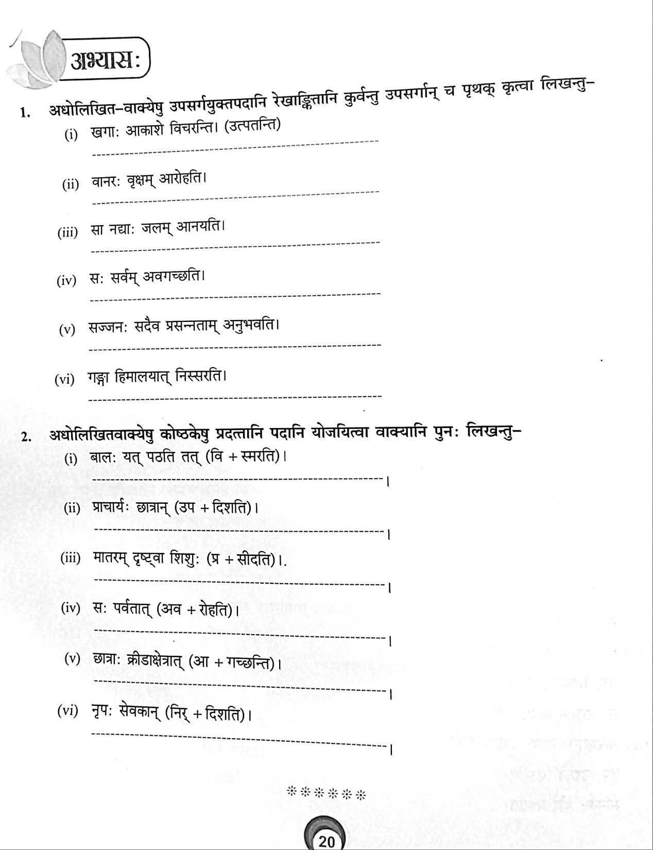

Slide 6
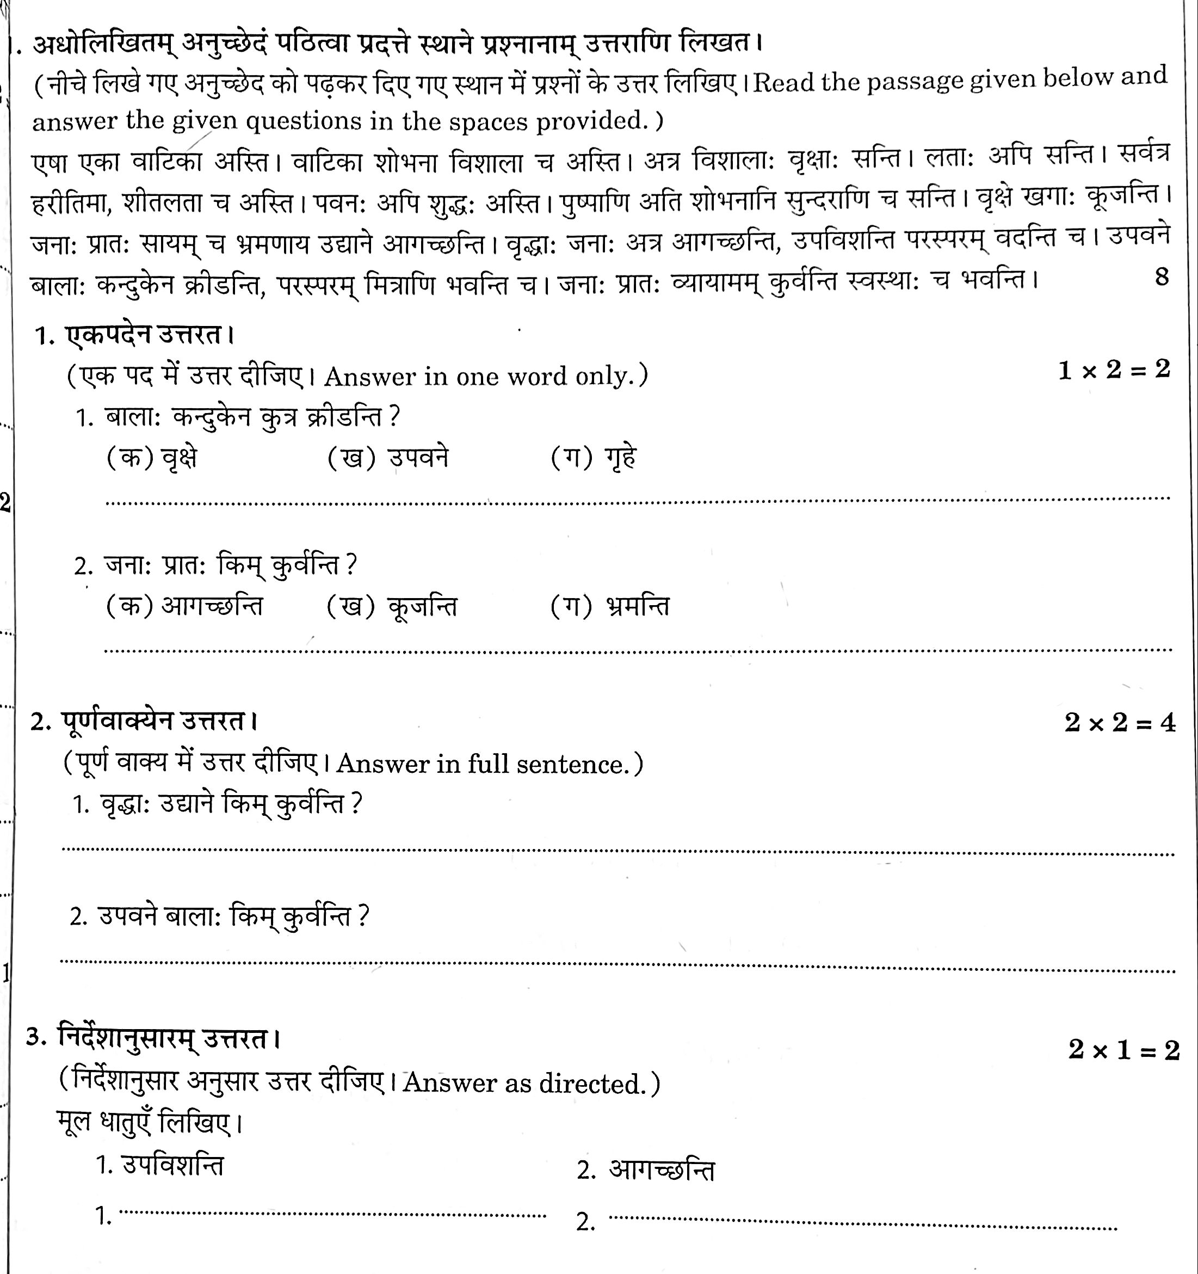

Slide 7
