Slide 1
DAV PUBLIC SCHOOL BERHAMPUR
STD : 7TH MATHEMATICS
SESSION : 2020 – 2021

Slide 2
Operation on
Rational Numbers
Multiplication and Division of Rational Number with Property
By
Mrs. Sasmita Mahapatra

Slide 3
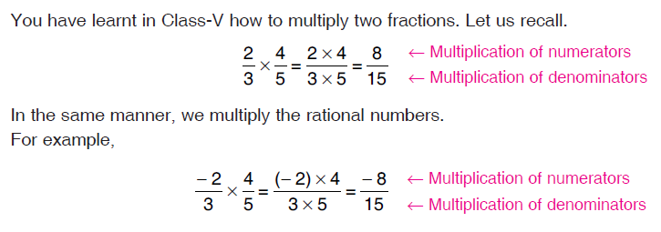
MULTIPLICATION OF RATIONAL NUMBERS

Slide 4
Important notes

Slide 5
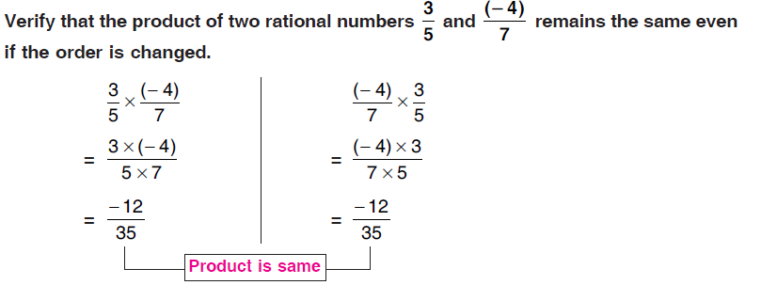
PROPERTIES OF MULTIPLICATION OF RATIONAL NUMBERS
Property – 1 :-
Product of two rational numbers remains the same even if we change their order,
i.e. if x and y are rational numbers, then
x × y = y × x.
This is known as commutative law of multiplication.

Slide 7
So from the above example we observed that
Property – 2:- Product of two rational number remains the same even when we change the grouping of rational numbers,
i.e. if x , y and z are rational numbers, then
( x × y ) × z = x × ( y × z)
This is called as associative law of multiplication.

Slide 9
So from the above example we observed that
Property-3:-
Product of a rational number and zero is zero,
i.e. if x is any rational number, then
x × 0 = 0 × x = 0

Slide 10
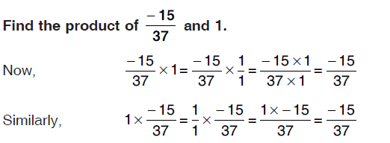

Slide 11
So from the above example we observed that
Property-4:-
One multiplied by any rational number is the number itself.
i.e. if x is a rational number, then x × 1 = 1 × x = x
i.e. 1 is an identity element under multiplication

Slide 13
So from the above example we observed that Property-5:-
If x, y and z are rational numbers, then
x × (y + z) = x × y + x × z
x × (y – z) = x × y – x × z
This is distributive law of multiplication over addition.
We illustrate (ii) with the help of the following example .

Slide 14
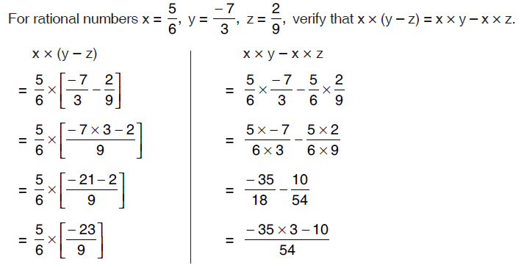

Slide 15
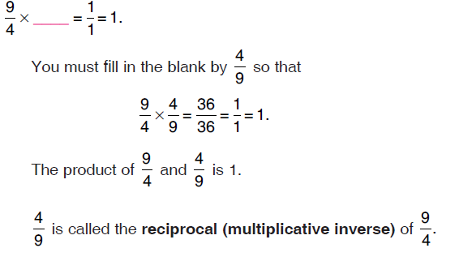
RECIPROCAL OF A RATIONAL NUMBER
Reciprocal of Rational Number means interchanging of numerator and denominator. In order words, Rational Number obtained after inverting the given rational number is called Reciprocal of Rational Number
Let us consider a rational number 9/4. We try to find a rational number which when multiplied by 9/4 gives us the result 1. In other words, let us try to fill in the blanks so that the statement

Slide 16
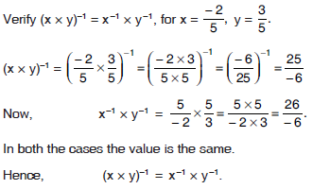
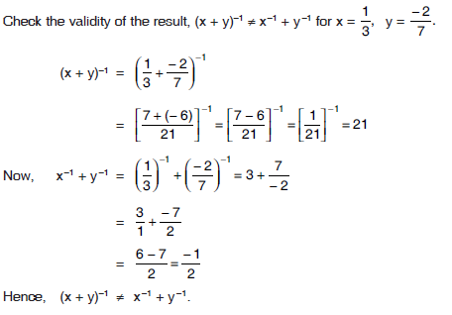
Lets see some examples:-
Example -1
Example – 2:-

Slide 17
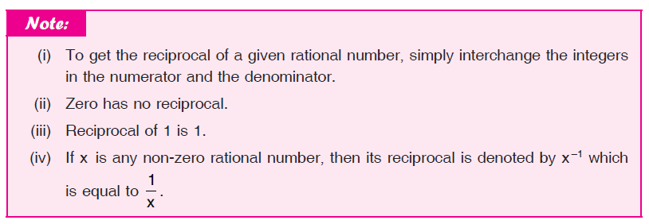
Important Notes
Two non zero numbers a/b and b/a are reciprocals of each other.

Slide 18
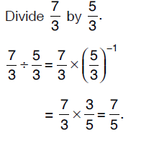
DIVISION OF RATIONAL NUMBERS
A division sign is often displayed between two rational numbers and it expresses that the first rational number has to divide by the second rational number. In fact, a rational number cannot be divided directly by another one due to their complex expression. Hence, we have to use a special procedure to find the quotient of them mathematically.
Steps
Keep the one rational number as it is but multiply it by the reciprocal of the another rational number.
Multiply the rational numbers, then find the product of them.

Slide 19
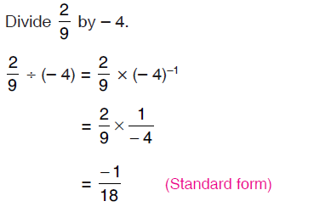

Slide 20
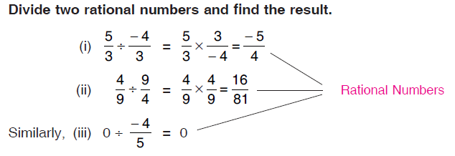
PROPERTIES OF DIVISION OF RATIONAL NUMBERS
Property 1:
Division of a rational number by another rational number except zero, is a rational number.

Slide 21
Property 2:
When a rational number (non-zero) is divided by the same rational number, the quotient is one.

Slide 22
Property 3:
When a rational number is divided by 1, the quotient is the same rational number.

Slide 23
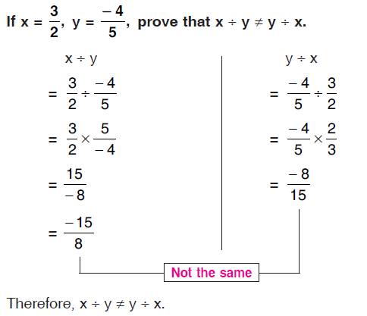
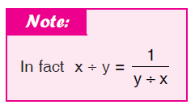
Property 4:
If x and y are non-zero rational numbers, then in general, x ÷ y ≠ y ÷ x i.e. commutative property does not hold true for division.

Slide 24
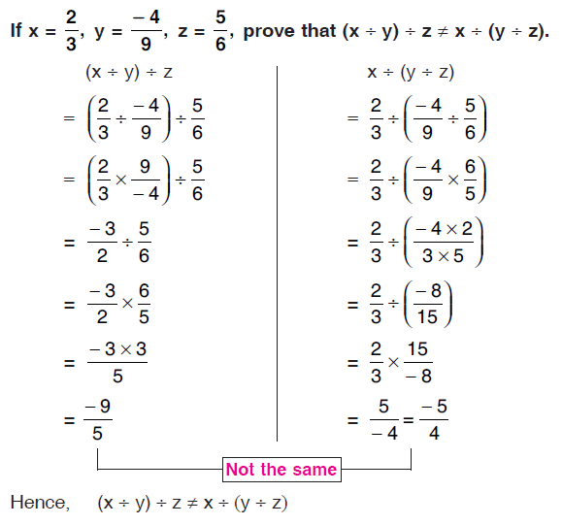
Property – 5
If x, y and z are non-zero rational numbers, then, in general
(x ÷ y) ÷ z ≠ x ÷ (y ÷ z),
i.e. associative property does not hold true for division.

Slide 25
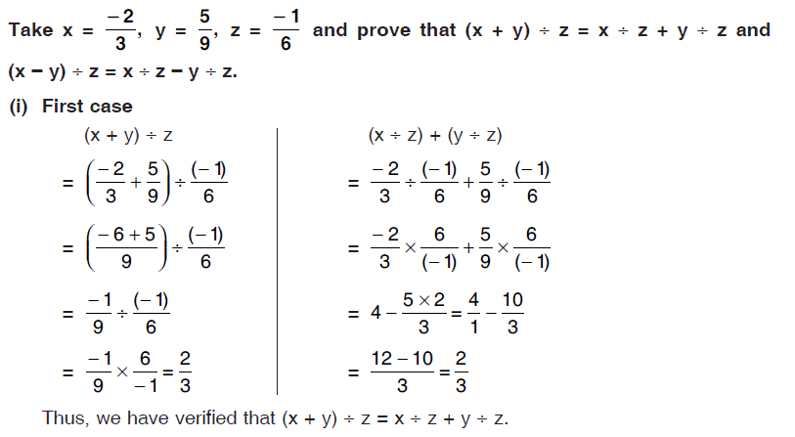

Slide 26
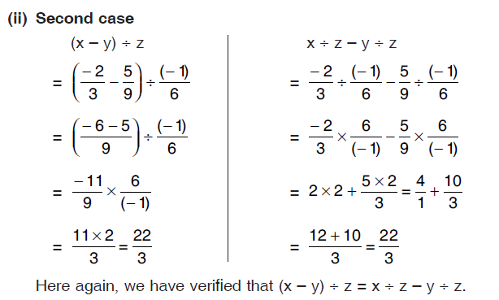
Property – 6 :
If x, y and z are rational numbers, then (x + y) ÷ z = x ÷ z + y ÷ z and (x – y) ÷ z = x ÷ z – y ÷ z

Slide 27
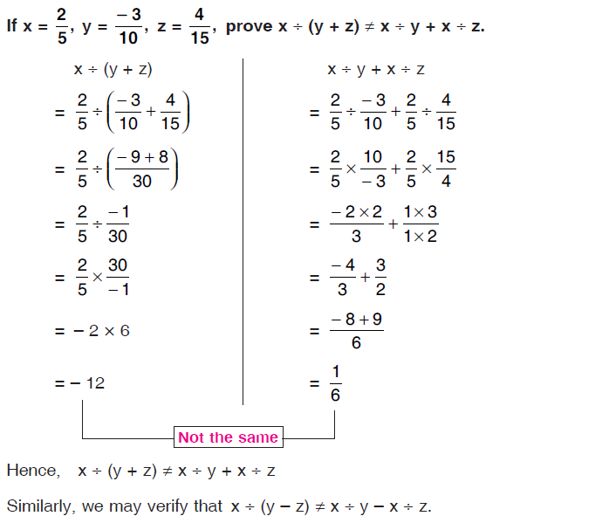
Property 7:
For three non-zero rational numbers x, y and z, x ÷ (y + z) ≠ x ÷ y + x ÷ z, i.e. distributive property does not hold true for division.

Slide 28
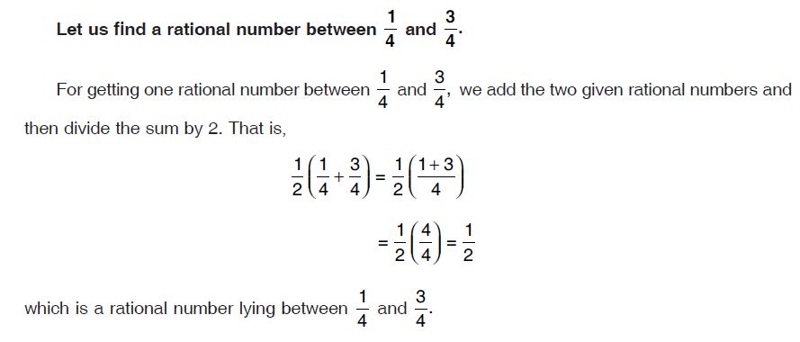
RATIONALS BETWEEN TWO RATIONAL NUMBERS

Slide 29
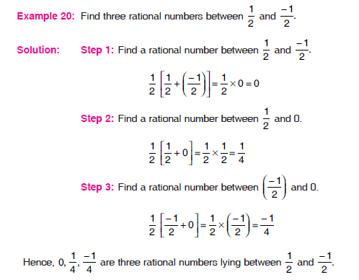
Between any two rational numbers, there are infinitely many rational numbers.

Slide 30
Self Assessment – 4
1. Multiply each of the following rational numbers:
(i) 7/11 by 5/4
(ii) 5/7 by (-3/4)
(iii) (-2)/9 by 5/11
(iv) -3/17 by -5/-4
2. Find the product of each of the following:
(i) 3/5 × (-7)/8 (ii) (-9)/2 × 5/4 (iii) (-6)/11 × 5/3 (iv) (-2)/3 × 6/7
(v) (-12)/5 × 10/-3
(vi) 25/-9 × 3/-10 (vii) 5/-18 × -9/20 (viii) (-13)/15 × (-25)/26 (ix) 16/-21 × 14/5 (x) (-7)/6 × 24 (xi) 7/24 × (-48) (xii) (-13)/5 × (-10)
3. Find the reciprocal of: (i) 13/25 (ii) (-17)/12 (iii) (-7)/24 (iv) 18 (v) -16

Slide 31
4. Fill in the blanks: (i) The product of a rational number and its reciprocal is __________ . (ii) Zero has __________ reciprocal. (iii) The numbers __________ and __________ are their own reciprocals. (iv) Zero is __________ the reciprocal of any number. (v) The reciprocal of a, where a ≠ 0, is __________ . (vi) The reciprocal of 1/a, where a ≠ 0, is __________ . (vii) The reciprocal of a positive rational number is __________ . (viii) The reciprocal of a negative rational number is __________ .
5. Find the value of:
(“^” means to the power) (i) (5/8)^-1 (ii) (-4/9)^-1 (iii) (-7)^-1 (iv) (1/-3)^-1
6. Simplify each of the following and express the result as a rational number:
(i) -16/21 × 14/5
(ii) 7/6 × -3/28
(iii) -19/36 × 16
(iv) -13/9 × 27/-26

Slide 32
Answers – 4
1. (i) 35/44
(ii) -15/28
(iii) -10/99
(iv) -15/68
2. (i) -21/40
(ii) -45/8
(iii) 10/11
(iv) -4/7
(v) 8
(vi) 5/8
(vii) 1/8
(viii) 5/6
(ix) -32/15
(x) -28
(xi) -14
(xii) 26
3. (i) 25/13
(ii) 12/-17
(iii) 24/-7
(iv) 1/18
(v) 1/-16
4. (i) 1
(ii) No
(iii) 1, -1
(iv) Not
(v) 1/a
(vi) a
(vii) Positive
(viii) Negative
5. (i) 8/5
(ii) -9/4
(iii) -1/7
(iv) -3
6. (i) -32/15
(ii) -1/8
(iii) -76/9
(iv) 3/2

Slide 33
Self Assessment – 5
1. Multiply the rationals:
(i) -5/17 by 51/(-60)
(ii) -6/11 by -55/36
(iii) -8/25 by -5/16
(iv) 6/7 by -49/36
2. Verify each of the following: (i) 4/17 × (-7)/9 = (-7)/9 × 4/17 (ii) (-8)/11 × 1/5 = 1/5 × (-8)/11 (iii) (-12)/5 × 7/(-36) = 7/-36 × (-12)/5 (iv) -8 × (-13)/12 = (-13)/12 × (-8)
3. Verify each of the following:
(i) (3/5 × 12/13) × 7/18 = 3/5 ×(12/13 × 7/8) (ii) (-13)/24 × {(-12)/5 × 35/36} = {(-13)/24 × (-12)/5} × 35/36 (iii) {(-9)/5 × (-10)/3} × 21/-4 = (-9)/5 × {(-10)/3 × 21/-4}
4. Fill in the blanks: (i) (-23)/17 × 18/35 = 18/35 × (_____) (ii) -38 × (-7)/19 = (-7)/19 × (_____) (iii) {15/7 × -21/10} × (-5)/6 = (_____) × {(-21)/10 × (-5)/6} (iv) (-12)/5 × {4/15 × 25/-16} = {(-12)/5 × (4/15) × (_____)
5. Find the multiplicative inverse of:
(i) -11/-15 (ii) -5 (iii) 0/7 (iv) 2/-5 (v) (-1)/8

Slide 34
6. Verify the following rational numbers using the multiplication properties: (i) 3/7 × {5/6 + 12/13} = (3/7 × 5/6) + (3/7 × 12/13) (ii) -15/4 × (3/7 + (-12)/5) = (-15/4 × 3/7) + (-15/4 × (-12)/5) (iii) (-8/3 + -13/12) × 5/6 = (-8/3 × 5/6) + (-13/12 × 5/6) (iv) -16/7 × {-8/9 + (-7)/6} = (-16/7 × (-8)/9) + ((-16)/7 × -7/6)
7. Name the property of multiplication illustrated by the following statements: (i) -11/13 × -17/5 = -17/5 × -11/13 (ii) {(-2)/3 × 7/9} × (-9)/5 = (-2)/3 × {7/9 × (-9)/5} (iii) (-3)/4 × {(-5)/6 + 7/8 = {(-3)/4 × (-5)/6} + {(-3)/4 × 7/8} (iv) (-16)/9 × 1 = 1 × (-16)/9 = (-16)/9 (v) (-11)/15 × 15/-11 = 15/-11 × (-11)/15 = 1 (vi) -7/5 × 0 = 0

Slide 35
Answers – 5
1. (i) 1/4
(ii) 5/6
(iii) 1/10
(iv) -7/6
4. (i) -23/17
(ii) -38
(iii) 15/7
(iv) 25/-16
5. (i) -15/-11
(ii) 1/-5
(iii) Does not exist
(iv) -5/2
(v) 8/-1
7. (i) Commutative property
(ii) Associative property
(iii) Distributive property
(iv) Property of multiplicative identity
(v) Property of multiplicative inverse
(vi) Multiplicative property of 0

Slide 36
Self Assessment – 6
1. Divide the rationals:
(i) 1 by 1/2
(ii) 5 by -5/7
(iii) -3/4 by 9/-16
(iv)-7/8 by -21/16
(v) 7/-4 by 63/64
(vi) 0 by -7/5
(vii) -3/4 by -6
(viii) 2/3 by -7/12
2. Simplify:
(i) 4/9 ÷ -5/12 (ii) -8 ÷ (-7/16) (iii) -12/7 ÷ (-18) (iv) (-1/10) ÷ (-8/5) (v) (-16/35) ÷ (-15/14) (vi) {(-65/14) ÷ (13/7)}

Slide 37
3. The product of two rational numbers is 15. If one of the numbers is -10, find the other.
4. The product of two rational numbers is -9. If one of the numbers is -12, find the other. 5. The product of two rational numbers is -16/9. If one of the numbers is -4/3, find the other. 6. By what rational number should we multiply -15/56 to get -5/7? 7. By what rational number should -8/39 be multiplied to obtain 1/26? 8. By what number should -33/8 be divided to get -11/2?
9. The product of two rational numbers is -8/9. If one of the numbers is -4/15, find the other.
10. By what number should we multiply -1/6, so that the product may be -23/9?
11. By what number should -33/16 be divided to get -11/4?
12. Fill in the blanks:
(i) 9/8 ÷ (_____) = -3/2 (ii) (_____) ÷ (-7/5) = 10/19 (iii) (_____) ÷ (-3) = -4/15 (iv) (-12) ÷ (_____) = -6/5

Slide 38
Answers – 6
1. (i) 2
(ii) -7
(iii) 4/3
(iv) 2/3
(v) -16/9
(vi) 0
(vii) 1/8
(viii) -8/7
2. (i) -16/15
(ii) 128/7
(iii) 2/21
(iv) 1/16
(v) 32/75
(vi) -5/2
3. -3/2
4. 3/4
5. 4/3
6. 8/3
7. -3/16
8. 3/4
9. 10/3
10. 46/3
11. 3/4
12. (i) -3/4
(ii) -14/19
(iii) 4/5
(iv) 10

Slide 39
Self Assessment – 7
1. Find out a rational numbers lying between 1/4 and 1/3.
2. Find out a rational number lying between 2 and 3.
3. Find out a rational number lying between -1/3 and 1/2.
4. Find out two rational numbers lying between -3 and -2.
5. Find out six rational numbers lying between -4/8 and 3/8.
6. Find out ten rational numbers lying between 7/13 and -4/13.
7. Find out three rational numbers lying between 4 and 5. 8. Find out three rational numbers lying between 2/3 and 3/4.
9. State true or false:
(i) Between any two distinct integers there is always an integer.
(ii) Between any two distinct rational numbers there is always a rational number.
(iii) Between any two distinct rational numbers there are infinitely many rational numbers.

Slide 40
Answers – 7
1. 7/24 2. 5/2 3. 1/12 4. -5/2, -9/4
5. -3/8, -2/8, -1/8, 0/8, 1/8, 2/8
6. -3/13, -2/13, -1/13, 0/13, 1/13, 2/13, 3/13, 4/13, 5/13, 6/13
7. 17/4, 9/2, 19/4 8. 33/48, 17/24, 35/48
9. (i) False
(ii) True
(iii) True

