Slide 1
UNIT -1 STD -VI ENGLISH LITERATURE
HOW DADDY DECIDED WHAT HE WANTED TO BE
BY : ALEXANDER RASKIN

Slide 2
PAGE -1 PRE-READING TASK
Answer the following
What is your father’s profession ?
What profession would you like to choose ?
What is the reason for your choice ?

Slide 3
About the author
How Daddy Decided What He Wanted to Be by Alexander Raskin are written by the author about his life when he was small. These are not fantasies are rather realistic happenings about Alexander's day-to-day life. It's a daddy's story to his daughter who was sick. This speaks about the thoughts of what the author wanted to become once he grew up.

Slide 5
Difficult words and their meanings
Nightwatchman - a person whose job is to guard a building at night
Quite – completely , entirely, fully
Certain – sure, definite
Locomotives – railway engines

Slide 6
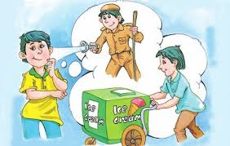
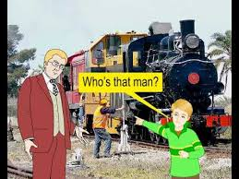
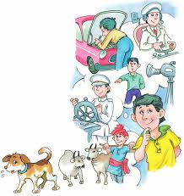
Pictures related to chapter

Slide 7
Questions related to page 1
(when daddy....................wonderful game)
Why did Daddy wanted to be a nightwatchman ?
Why did Daddy wanted to be an ice-cream seller?
How did Daddy’s parents react when they came to know about their son’s profession ?
Read the following extract and answer the following questions :
“ He was quite certain he wanted to be a nightwatchman when he grew up.”
Who is ‘He’ in the above line ?
From which lesson the extract has been taken ?
Who is the author of this lesson ?
(Please check slide 8 for correct answer )

Slide 8
Answer Key
At night a watchman is up while town is asleep. He can also make noise when everyone is sleeping .That is why Daddy wanted to become a nightwatchman .
(or)
Daddy wanted to be a nightwatchman because the job of a watchman was both attractive and exciting. He was awake while the whole town slept. The watchman kept shouting while others were sleeping .
2. He wanted to be ice-cream man because if he became an ice-cream man, he could have a cart and eat all the ice-cream he wanted to .
3. Little Daddy’s parents were surprised when they came to know their son’s decision of being an ice-cream seller .
4. Extract :
Little Daddy is ‘he’ in the above extract .
The extract has been taken from the lesson ‘How Daddy decided what he wanted to be’.
Alexander Raskin is the author of the above extract .

Slide 9
HOME WORK
Write a paragraph about what profession you like to choose and what is the reason for your choice ? (write within 80 words )

Slide 10
Page -2
(whose that man...........................his whip loudly)

Slide 11
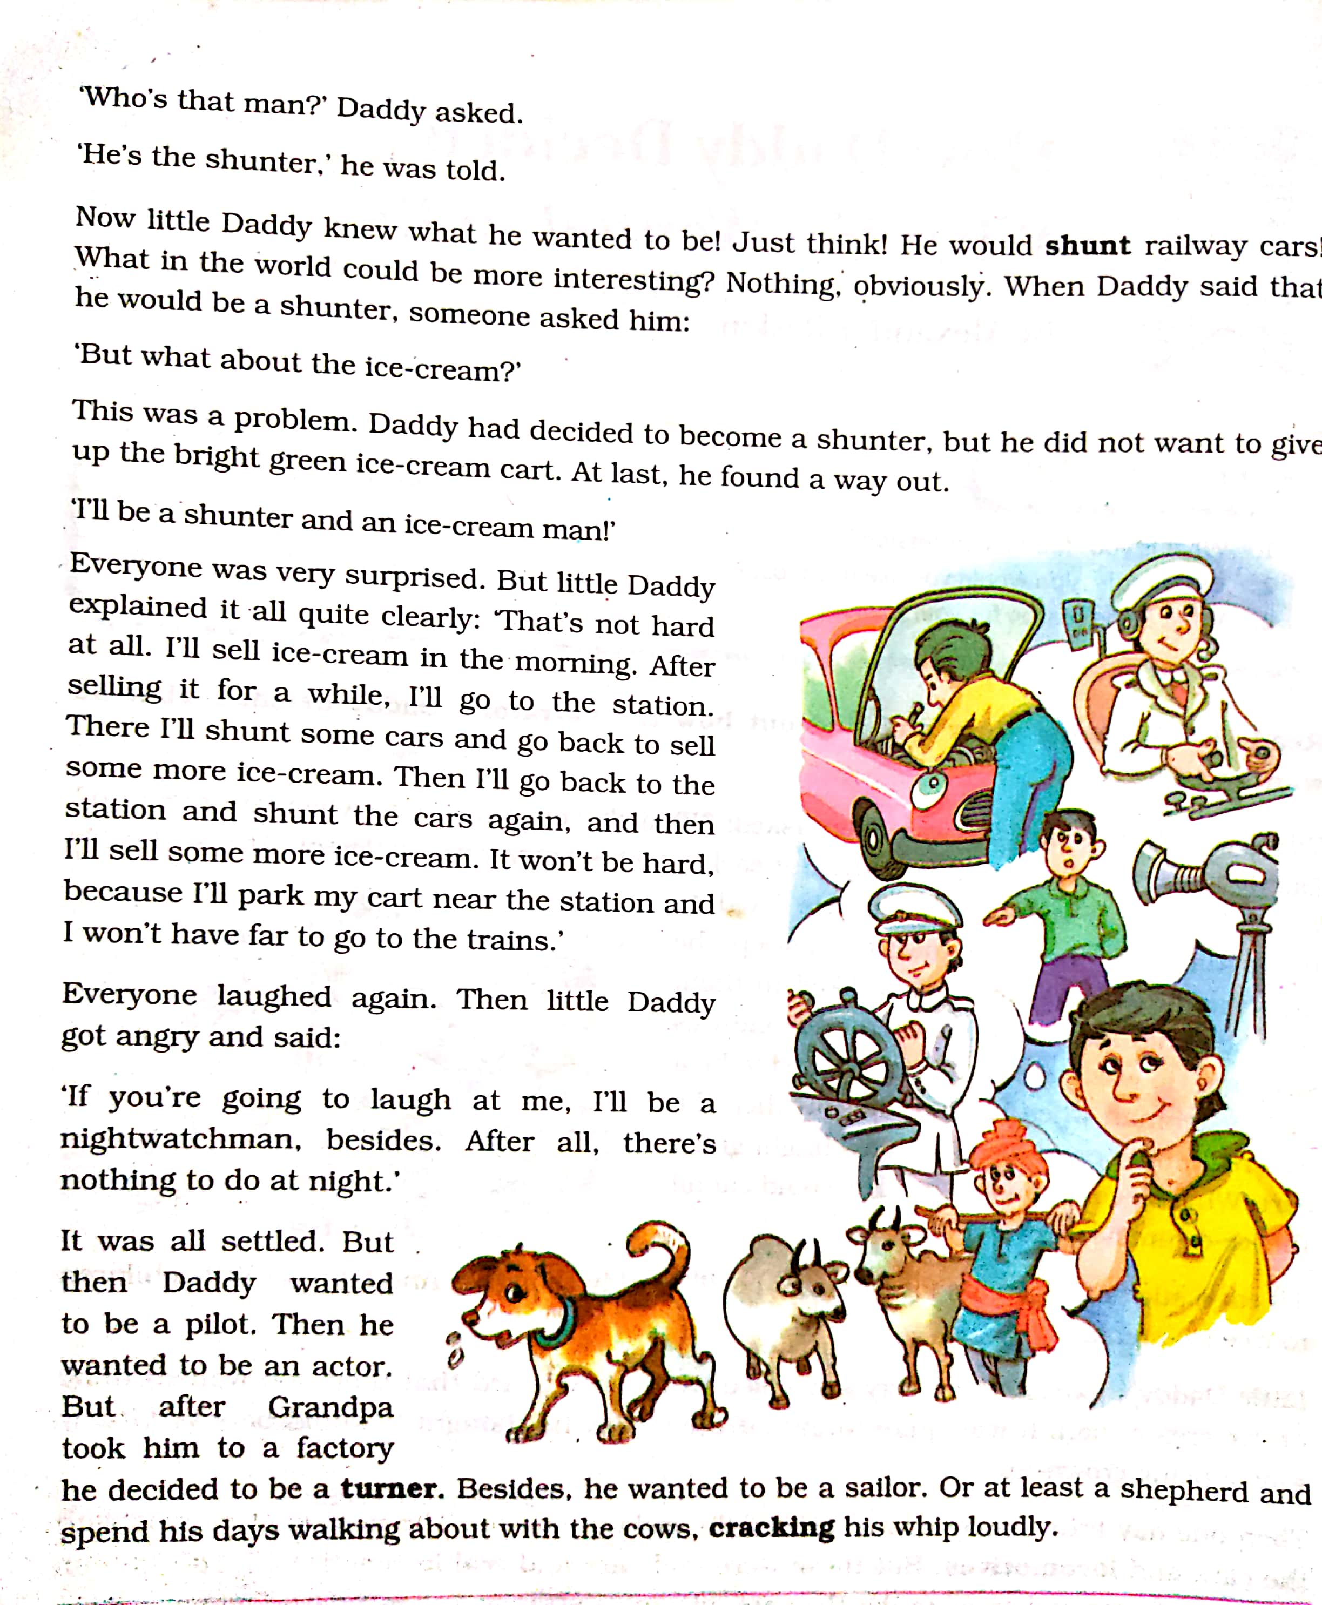

Slide 12
Word Meanings
1.Shunt-to move a carriage from one track to another.
2.Cracking-making a sharp noise with a whip.
3.Turner-a person who operates a lathe
4.Lathe-a machine for shaping wood, metal or other materials by means of a rotating drive.

Slide 13
Comprehensive Questions
1.Little Daddy wanted to be a shunter as well as an ice cream seller and a night watchman. What were his plans to manage it?
2.Name the other professions Little daddy wanted to pursue before deciding to be a dog.

Slide 14
Life Skills
Is it practically possible to practice two or three professions simultaneously. Explain.
Extract :
Read the following extract and answer :-
‘I’ll be a shunter and an ice cream man!’.
Q1.Whom does ‘I’ refer to?
Q2.Why does the speaker want to be a shunter?
Q3.Where would he park his ice cream cart?

Slide 15
Answers of Pg-2
Little Daddy decided that in the morning he would sell ice cream for a while and then go to the station for shunting some cars and at night he would work as a night watchman.
Little Daddy also wanted to be a pilot,an actor,a turner, a sailor and also a shepherd before becoming a dog.

Slide 16
Home work
Use any of the prefixes (in/ un / dis ) to make the opposites
Real -
Easy -
Active -
Honour -
Respect-
Obey -

Slide 17
PAGE -3
(Finally he ................and walked away)

Slide 19
Difficult words and their meanings
Strangers – a person whom one does not know or with whom one is not familiar
Pat – touch gently with the flat of the hand
Scratch – mark the surface with a sharp or pointed object

Slide 20
Answer the following questions
What did Daddy do when an elderly lady wanted to pat his head ?
2. Why did Daddy want to scratch behind his ear with his foot ?
3. What was it that made Daddy feel ashamed of himself ?
4. Read the following extract and answer the following questions :
“Don’t you want to remain human?”
Who is ‘you’ in the above extract ?
Who is the speaker in the above extract ?
(please check slide no 5 for correct answer )

Slide 21
Answer key
Daddy tried to bite the elderly lady when she tried to pat his head .
Daddy wanted to scratch behind his ear with his foot because he wanted to be a dog .
Daddy felt ashamed of himself when a gentleman(officer) asked him to think of himself . He said that Daddy was unable to understand what a man is like.
Extract :
Little Daddy is you in the above extract .
The officer is the speaker in the above extract

Slide 22
Home work
Read the following extract and answer the following questions :
“what are you doing”?
Who said to whom ?
Who is the author of the above extract ?

Slide 23
Page -4
(he wasn’t laughing ..................ear with his foot )

Slide 25
Difficult words and their meanings
Ashamed - sorry, embarrassed, guilty because of one’s action

Slide 26
Answer the following questions
When did Daddy stop thinking what he wanted to be ?
What does Daddy think now be the most important thing?
3. Read the following extract and answer the following questions :
“I want to be a human being”.
Who is I in the above line ?
(please refer slide no. 5 for correct answer )

Slide 27
Answer Key
Daddy stopped thinking what he wanted to be when he realized that he was yet too small to know what he wanted to be .
Daddy thinks that the most important thing is to be a good man .
Extract :
Little Daddy is I in the above extract .

Slide 28
Video Link
https://youtu.be/4uxyFQrrUWg

Slide 29
Test yourself
Writing skills :
After meeting the officer , Daddy feels ashamed of himself. He makes a resolution. Imagine yourself to be Daddy and write a diary entry expressing your feelings .

Slide 30
THANK YOU CHILDREN
SUBMITTED BY : SUCHARITA DAS
A. JAYSHREE PATTNAIK

