Slide 1
Chapter 02 Sexual Reproduction in Flowering Plants By Ms Madhusrabani Patro, PGT Biology DAV Public School , Berhampur

Slide 2
Flower
Modified shoot
Develops from floral primordia
Primordia develop first into floral bud and then into a flower.
Reproductive part of plant
Androecium is male reproductive whorl, consists of stamens.
Gynoecium is female reproductive part of flower, consists of carpel(S).

Slide 3
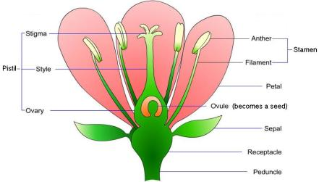
FLOWER, A FASCINATING ORGAN OF ANGIOSPERMS
Male reproductive organ
Female reproductive organ
Stamen
*Anther – produces sperm nuclei by meiosis. Sperm nuclei are enclosed by pollen grains.
*Filament – holds the anther up
Pistil
*Stigma –top of the pistil,
Sticky surface for pollen to stick to
*Style – connects the stigma to the ovary
*Ovary –contains ovules

Slide 4
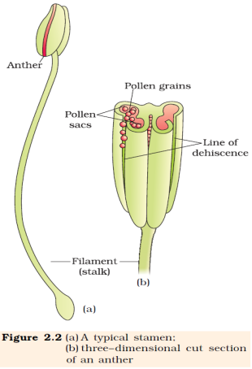
Stamen, Anther
The androecium consists of whorls of stamen.
The stamen consists of the filament (long and slender
stalk) and anther (bilobed structure).
Filament is attached to the thalamus or to the petal.
● Anther:
A typical angiospermic anther is bilobed and each lobe is dithecous (consists of two theca).
Theca are separated by a longitudinal groove running lengthwise.
The microsporangia are located at the corners, two in
each theca. They further develop to form pollen sacs,
which contain the pollen grains.

Slide 5
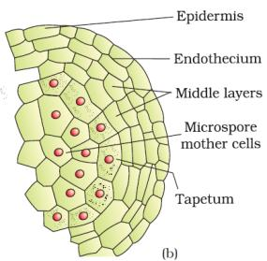
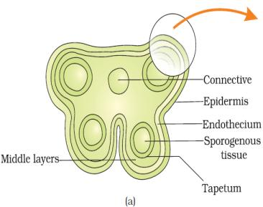
STRUCTURE OF MICROSPORANGIUM
The microsporangium is surrounded by four wall layers (epidermis, endothecium, middle layers, and tapetum).
The outer three layers are protective and help in dehiscence of anther to release the pollen grains. The tapetum provides nourishment to the developing pollen grains. Cells of the tapetum possess dense cytoplasm and generally have more than one nucleus.
In the young anther, the sporogenous tissue forms the centre of each microsporangium.

Slide 6
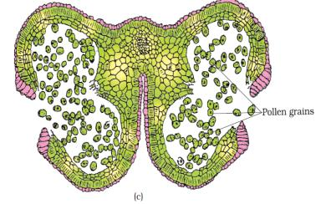
MICROSPOROGENESIS
The process of formation of microspores from a pollen mother cell through meiosis is called microsporogenesis.
The cells of sporogenous tissue undergo meiosis to form microspore tetrad arranged in a cluster of 4 cells..
As each cell of sporogenous tissue has potential to form tetrad, so each cell is a microspore mother cell (PMC).
On maturation and dehydration of anther, the spores dissociate and develop into pollen grains.
Pollen grains release with the dehiscence of anther.

Slide 7
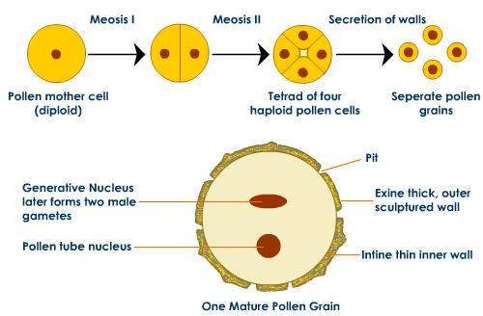
MICROSPOROGENESIS & STRUCTURE OF A POLLEN GRAIN
MICROSPOROGENESIS & STRUCTURE OF A POLLEN GRAIN

Slide 8
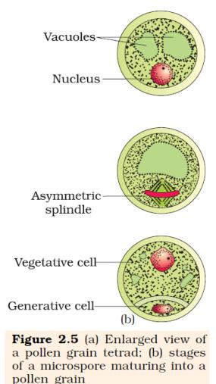
Pollen grain
Pollen grain represent the male gametophyte and are spherical, having a two layered wall:
○ Exine (outer) − Hard layer made of sporopollenin, which is extremely resistant and can withstand high temperatures, acidic and alkaline conditions, and enzymes
○ Intine (inner) − Thin and continuous layer made up of cellulose and pectin.
● Mature pollen grain contains two cells:
○ Vegetative cell − Large with irregular nucleus, contains food reserves
○ Generative cell − Small and floats in the cytoplasm of the vegetative cell
In 60% of the angiosperms, pollen grains are shed at 2- celled stage while in others generative cell undergoes mitosis to form two male gametes (3-celled stage).

Slide 9
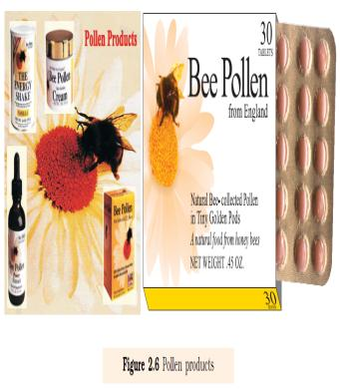
The viability of pollen grains after they are shed depends upon temperature and humidity. It ranges from 30 minutes such as rice and wheat to few months in some members of Rosaceae, Leguminoseae and Solanaceae,
It is possible to store pollen grains of a large number of species for years in liquid nitrogen (-1960C) called cryopreservation. Such stored pollen can be used as pollen banks, similar to seed banks, in crop breeding programmes.
Pollen grains are rich in nutrients and hence are used as pollen tablets as food supplements.
In western countries, a large number of pollen products in the form of tablets and syrups are available in the market. Pollen consumption has been claimed to increase the performance of athletes and race horses
Pollen grains of many species cause severe allergies and bronchial afflictions in some people often leading to chronic respiratory disorders– asthma, bronchitis, etc. Parthenium or carrot grass that came into India as a contaminant with imported wheat, has become ubiquitous in occurrence and causes pollen allergy.

Slide 10
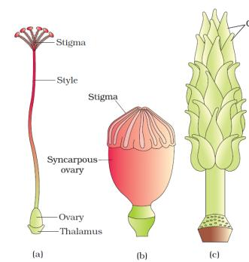
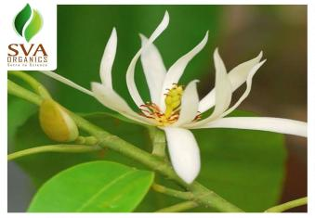
The Pistil, megasporangium and embryo
The gynoecium represents the female reproductive part of a flower.
● It may be mono-carpellary (one pistil) or multicarpellary (many pistils). In multi-carpellary, the pistils may be fused in one (syncarpous) or free (apocarpous).
● Each pistil consists of:
○ Stigma − Receives the pollen grains
○ Style − Elongated, slender part below the stigma
○ Ovary − Bulged basal part containing the placenta, which is located inside the ovarian locule (cavity) The placenta contains the megasporangia or ovules.
Figure 2.7 (a) A dissected flower of Hibiscus showing pistil (other floral parts have been removed); (b) Multicarpellary, syncarpous pistil of Papaver ; (c) A multicarpellary, apocarpous
gynoecium of Michelia;

Slide 11
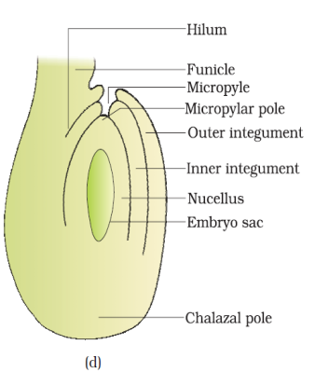
Megasporangium/ Ovule
● The ovule is attached to the placenta by the funicle. The junction of the ovule and the funicle is called hilum.
● Each ovule has one or two protective layers, called
integuments, which cover the rest of the ovule, except for a small opening called micropyle.
● The chalaza lying on the opposite side of the micropyle end represents the basal part of the ovule.
● Nucellus is present within the integuments and contains reserved food. The embryo sac or female gametophyte is located within the nucellus.
Located in the nucellus is the embryo sac or female gametophyte.

Slide 12
One of the nucellar cell in the micropylar region is differentiated into megaspore mother cell.
The cell is larger, contains dense cytoplasm and a prominent nucleus. It undergoes meiosis forming 4 haploid cells called megaspore tetrad.
3 megaspores degenerate and only one megaspore become functional.
In most flowering plants, only one megaspore is functional while the other three degenerate.
The single functional megaspore develops into the female gametophyte. This kind of development is called monosporic development.
The nucleus of the functional megaspore divides mitotically to form 2 nuclei, which move towards the opposite ends, forming a 2-nucleate embryo sac. Two more mitotic divisions ensue, leading to the formation of 4-nucleate and 8-nucleate embryo sacs.
● After the 8-nucleate stage, the cell walls are laid down and the typical female gametophyte (embryo sac) gets organised.
● Six of the 8-nuclei get surrounded by the cell wall and the remaining two, called polar nuclei, are situated below the egg apparatus in the large central cell.
● Three of the six cells are placed at the micropylar end and constitute the egg apparatus (2 synergids + 1 egg cell).
● The synergids have special thickenings at the micropylar end. These are together called the filiform apparatus.
Three cells are at the chalazal end, and are called antipodal cells.
● A typical angiosperm female gametophyte is 7-celled and 8- nucleated at maturity.

Slide 13
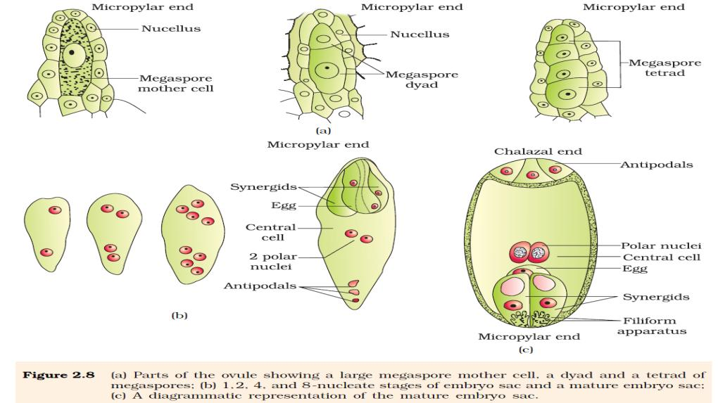

Slide 14
Pollination
Autogamy-: transfer of pollen grain from the anther to the stigma of the same flower.
Geitenogamy-: transfer of pollen grain from the anther to the stigma of another flower of the same plant
Xenogamy-: transfer of pollen grain from the anther to the stigma of different plant.

Slide 15
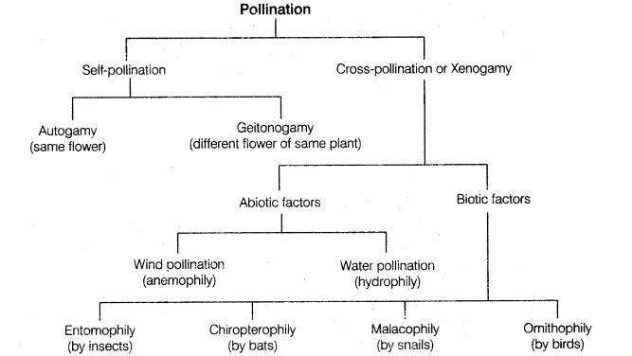

Slide 16
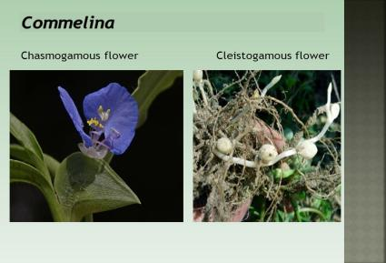
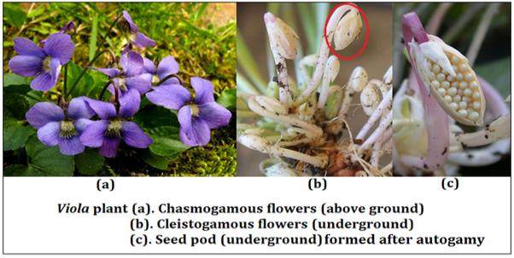
Autogamy
Autogamy − It is the transfer of pollen grains from the anther to the stigma of the same flower.
Autogamy requires the anther and the stigma to lie close. It also requires synchrony in the pollen release and stigma receptivity.
Plants like Viola, Oxalis, etc., produce two kinds of flowers—chasmogamous flowers (with exposed anther and stigma) and cleistogamous flowers (which do not open at all and only autogamy occurs).
Cleistogamous flowers produce assured seed-set even in the absence of pollinators.

Slide 17
Geitonogamy − It is the transfer of pollens from the anther of one flower to the stigma of another flower in the same plant. Genetically, it is similar to autogamy, but it requires pollinating agents. Xenogamy − It is the transfer of pollen grains from the anther to the stigma of a different plant. Pollination causes genetically different types of pollens to be brought to a plant. Agents of Pollination ● Plants use air, water (abiotic agents) and animals (bioticagents) for pollination.

Slide 18
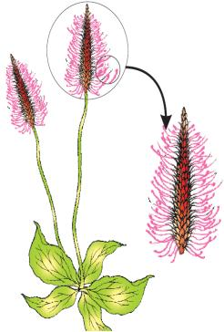
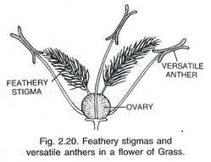
Adaptation Of Wind Pollinated Flowers
the pollen grains are light and non-sticky so that they can be transported in wind currents.
They often possess well-exposed stamens (so that the pollens are easily dispersed into wind currents,
large often-feathery stigma to easily trap air-borne pollen grains.
Windpollinated flowers often have a single ovule in each ovary
numerous flowers packed into an inflorescence;
a familiar example is the corn cob – the tassels you see are nothing but the stigma and style which wave in the wind to trap pollen grains. Wind-pollination is quite common in grasses.

Slide 19
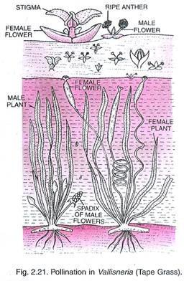
Adaptation Of Water Pollinated Flowers
Seen in submerged flowers like Vallisneria and Hydrilla and Zostera.
In Vallisneria male flowers released on water surface and female flowers reaches the surface for pollination.
In sea grasses, pollen grains are long ribbon like and carried passively to submerged female flowers.
Mucilage coated pollen grains.

Slide 20
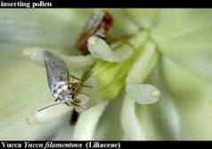
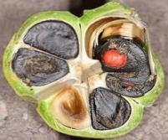
Pollination by animals
Large Brightly coloured and showy.
If flowers are small, grouped into inflorescence.
Highly fragrant
Produce nectar
Sticky pollen and stigmatic surface
Provide floral rewards to animal pollinator such as nectar, pollen or provide safe place for laying eggs.
In some species floral rewards are in providing safe places to lay eggs; an example is that of the tallest flower of Amorphophallus (the flower itself is about 6 feet in height). A similar relationship exists between a species of moth and the plant Yucca where both species – moth and the plant – cannot complete their life cycles without each other. The moth deposits its eggs in the locule of the ovary and the flower, in turn, gets pollinated by the moth. The larvae of the moth come out of the eggs as the seeds start developing.

Slide 24
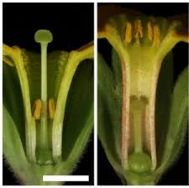
Heterostyle- In some other species, the anther and stigma are placed
at different positions so that the pollen cannot come in contact with
the stigma of the same flower.

Slide 25
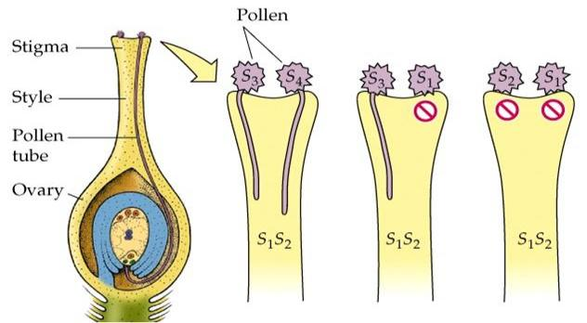
Self incompatibility

Slide 26
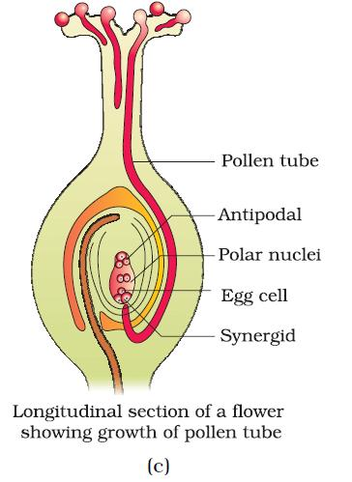
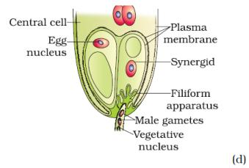
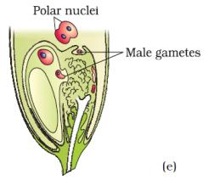

Slide 27
Recognition of compatible pollen-It is the interaction between chemical components of pollen and those of stigma. Pollination does not always ensure the transfer of compatible pollens. ● Hence, the pistil has the ability to recognise the right type of pollen to promote post- pollination events. ● If the pollen is of the wrong type, the pistil prevents pollen germination. ● This interaction is mediated by chemical components of the pollen and the pistil. ● Pollen−pistil interaction is a dynamic process involving pollen recognition, followed by promotion or inhibition of the pollen. ● The pollen tube reaches the ovary and enters the ovule through the micropyle. Then, through the filiform apparatus, it reaches synergids. In this way, the pollen tube grows. Pollen tube, after reaching the ovary, enters the ovule through the micropyle and then enters one of the synergids through the filiform apparatus All these events–from pollen deposition on the stigma until pollen tubes enter the ovule–aretogether referred to as pollen-pistil interaction.
Pollen-pistil Interaction :

Slide 28
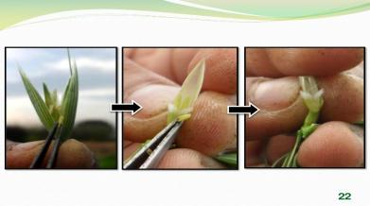
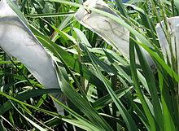
Artificial hybridisation
Artificial hybridisation is one of the major approaches of crop improvement programme.
In this method, it is essential to ensure that the right kinds of pollen grains are used, and the stigma is protected from unwanted pollen grains. It is achieved by:
Emasculation- If the female parent bears bisexual flowers, removal of anthers from
the flower bud before the anther dehisces using a pair of forceps is necessary..
Bagging- Emasculated flowers have to be covered with a bag of suitable size, generally made up of butter paper, to prevent contamination of its stigma with unwanted pollen.
When the stigma of bagged flower attains receptivity, mature pollen grains collected from anthers of the male parent are dusted on the stigma, and the flowers are rebagged, and the fruits allowed to develop.
Emasculation
Bagging

Slide 29
Double Fertilisation
● When the pollen grains fall on the stigma, the pollen tube enters one of the synergids and releases two male gametes.
● One of the male gametes moves towards the egg cell and fuses with it to complete the syngamy to form the zygote(2n)
● The other male gamete fuses with the two polar nuclei and forms triploid primary endosperm nucleus (PEN)(3n). This is termed as triple fusion.
● Since two kinds of fusion—syngamy and triple fusion—take place, the process is known as double fertilisation, and is characteristic of flowering plants.
● After triple fusion, the central cell becomes the primary endosperm cell (PEC). The primary endosperm nucleus gives rise to the endosperm, while the zygote develops into the embryo

Slide 30
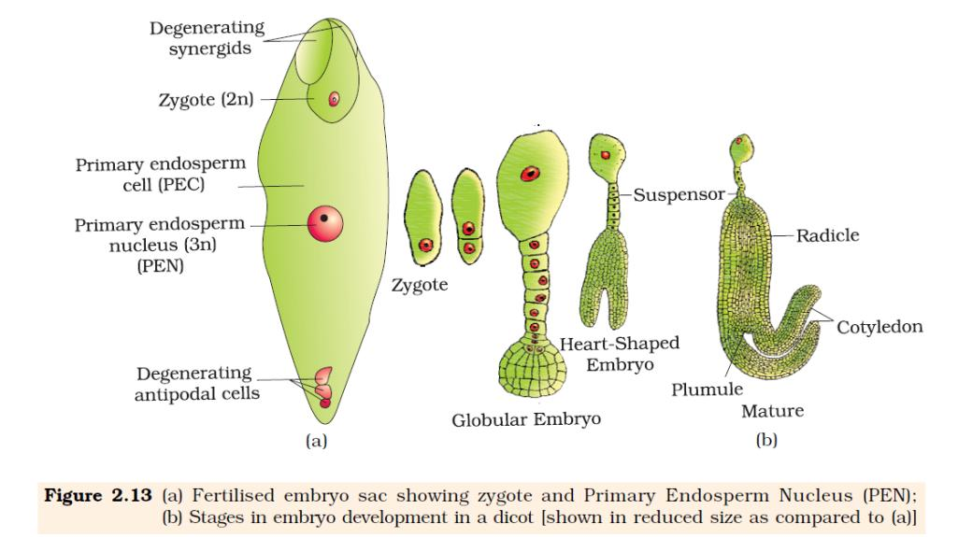

Slide 31
Post-Fertilisation Events
Endosperm
It includes development of endosperm and embryo, and maturation of ovules into seeds and ovaries into fruits.
Formation of Endosperm
● The endosperm develops before the embryo because the cells of the endosperm provide nutrition to the developing embryo.
● The primary endosperm nucleus repeatedly divides to give rise to free nuclei. This stage of development is called free nuclear endosperm. The coconut water from tender coconut that you are familiar with, is nothing but free-nuclear endosperm (made up of thousands of nuclei) and the surrounding white kernel is
the cellular endosperm.
● Cell wall formation occurs next, resulting in a cellular endosperm.
● The endosperm may be either fully consumed by the growing embryo (as in pea and beans) or retained in the mature seed (as in coconut and castor).

Slide 32
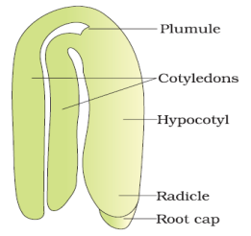
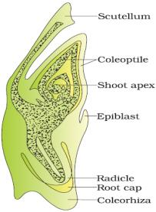
● The embryo develops at the micropylar end of the embryo sac where the zygote is situated. ● The zygote gives rise first to the pro-embryo, and then to the globular, heart-shaped, mature embryo. ● A typical dicot embryo consists of an embryonal axis and two cotyledons. ● The portion of the embryonal axis above the level of cotyledons is called epicotyl. It contains the plumule (shoot tip). The portion below the axis is called hypocotyl. It contains the radicle (root tip). The root tip is covered by the root cap. ● In a monocot embryo, there is only one cotyledon. In grass, it is known as the scutellum, and is situated at one side of the embryonal axis. At its lower end, the embryonal axis has the radicle and the root cap enclosed in the coleorrhiza. ● The epicotyl lies above the level of the scutellum, and has the shoot apex and leaf primordia enclosed in hollow structures called coleoptiles.
Development of Embryo
A typical dicot embryo
L.S. of an embryo of grass

Slide 33
● It is the last stage of sexual reproduction in angiosperms. ● Seeds are the fertilised ovules that are developed inside a fruit. ● A seed consists of: ○ Seed coat(s) ○ Cotyledon(s) ○ Embryonal axis ● Seeds may be albuminous (endosperm present; as in wheat and maize) or non-albuminous (endosperm absent; since it is consumed by the growing embryo; as in pea and beans). ● Some seeds such as black pepper and beet root have remnants of nucellus known as perisperm. ● The integuments of ovules harden to form the seed coat, and the micropyle facilitates the entry of oxygen and water into the seed. ● As it loses moisture, the seed may enter dormancy, or if favourable conditions exist, it germinates.
Development of Seeds

Slide 34
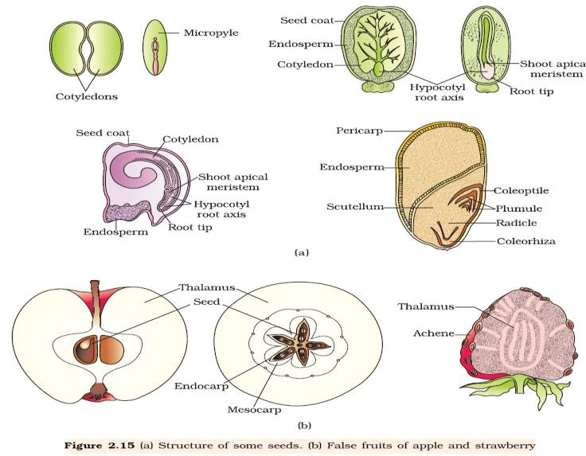
Quotations are commonly printed as a means of inspiration and to invoke philosophical thoughts from the reader.

Slide 35
Development of Fruits
● The ovary of a flower develops into a fruit.
● The walls of the ovary transform into the walls of the fruit (pericarp).
● Fruits may be fleshy, as in mango and orange, or can be dry, as in groundnut and mustard.
● In some plants, floral parts other than the ovary take part in
fruit formation, as in apple and strawberry. In these, the thalamus contributes to fruit formation. Such fruits are called false fruits like Apple, cashew . Fruits that develop from the ovary are called true fruits like Mango.
● Some fruits develop without fertilisation, and are known as parthenocarpic fruits (example: banana).

Slide 36
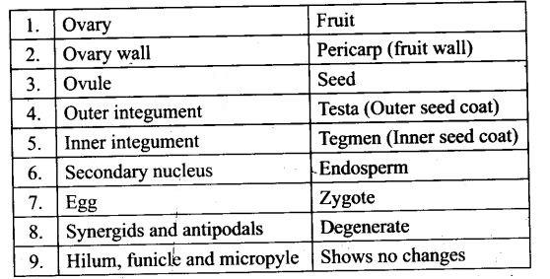

Slide 37
● Some plants produce seeds without fertilisation. This process of seed formation is known as apomixis. ● Apomixis is a form of asexual reproduction mimicking sexual reproduction. ● In some species, apomixis occurs as the diploid egg cell is formed without meiosis, and develops into embryo without fertilisation. ● In some varieties of citrus and mango, the nucellus cells divide and protrude into the embryo sac to develop into embryos. In such cases, each ovule may contain several embryos and this condition is called polyembryony. ● Apomixis is important for producing hybrid varieties of fruits and vegetables, and also for increasing crop yield multifold.
Apomixis and Polyembryony

Slide 38
Apomixis / Agamospory
Apomixis is the mechanism of seed production without involving the process of meiosis and syngamy. It plays an important role in hybrid seed production.
Seeds are formed without fertilisation.
It may develop if a diploid egg cell develops into embryo without fertilisation.
If cells of nucellus may develop into embryo and pushed into the embryo.
Significance-
The method of producing hybrid seeds by cultivation is very expensive for farmers. Also, by sowing hybrid seeds, it is difficult to maintain hybrid characters as characters segregate during meiosis. Apomixis prevents the loss of specific characters in the hybrid. Also, it is a cost-effective method for producing seeds.

Slide 39
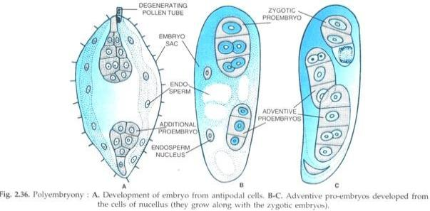
Special Reproduction (Polyembryony)
If more than one egg may form in embryo sac.
If more than one embryo sac formed in an ovule.
Other cells like synergids or nucellus develop into embryo.
E.g. orange, lemon, mango, onion, groundnut etc.

Slide 40
= Seeds offer several advantages to angiosperms. Firstly, since reproductive processes such as pollination and fertilisation are independent of water, seed formation is more dependable. =Also seeds have better adaptive strategies for dispersal to new habitats and help the species to colonise in other areas. =As they have sufficient food reserves, young seedlings are nourished until they are capable of photosynthesis on their own. =The hard seed coat provides protection to the young embryo. Being products of sexual reproduction, they generate new genetic combinations leading to variations. = Seed is the basis of our agriculture. Dehydration and dormancy of mature seeds are crucial for storage of seeds which can be used as food through out the year and also to raise crop in the next season. = In a few species the seeds lose viability within a few months. Seeds of a large number of species live for several years. =The oldest is that of a lupine, Lupinus arcticus excavated from Arctic Tundra. The seed germinated and flowered after an estimated record of 10,000 years of dormancy. = A recent record of 2000 years old viable seed is of the date palm, Phoenix dactylifera discovered during the archeological excavation at King Herod’s palace near the Dead Sea.
Seed

Slide 41
1.An anther with malfunctioning tapetum often fails to produce viable male gametophye. Give one reason.(1) 2.A bilobed dithecus anther has 100 microspore mother cell per microsporangium. How many male gametophyte this anther can produce?(2) 3. Some plants have a mechanism of shedding of pollen before maturation of stigma. Why?(3) 4.Does self incompatibility impose any restrictions in autogamy. Give reasons and suggest the method of pollination in such plants. 5.A flower of a tomato plant following the process of sexual reproduction produces 240 viable seeds. Answer the following questions giving reasons a)What is the minimum number of pollen grains that must have been involved in the pollination of it’s pistil? b)What would have been the minimum number of ovules present in the ovary? c)How many megaspore mother cells were involved? d)What is the minimum number of microspore mother cells involved in the above case? e)How many male gametes were involved in this case? 6.Give the common functions that the cotyledons and nucellus perform.(1) 7.In angiosperms zygote is diploid while PEN is triploid. How?(2) 8.Can an unfertilized apomictic embryosac give rise to a diploid embryo? Justify. 9.Strawberry is sweet and eaten raw. Why do Botanist call it a false fruit?
HOTS

Slide 42
1.The microscopic pollen grains of the past are obtained as fossils. Which compound makes this possible? (2)
2. Differentiate between the cells formed in 2-celled stage of the pollen grain (2)
3Differentiate between male gametophyte and female gametophyte (2)
4.Plants like Viola and Oxalis produce 2 types of flowers. Name and describe these 2 types of flowers. (2)
5.List any 4 differences between wind pollinated and insect pollinated flowers (2)
6.Geitonogamy is morphologically cross pollination but genetically self pollination. Explain (2)
Yucca and moth cannot complete their life cycles without each other. Explain. (2)
7.Explain with the help of a series of diagrams the development of a mature embryo sac from a megaspore mother cell in an angiosperm (5)
8.Draw a diagrammatic sketch of the sectional view of a typical angiospermic ovule and label it’s parts (3)
9.Explain the mode of pollination of Vallisneria.How is the pollination of water lilly different from that of Vallisneria (3)
10.Make a list of any three out breeding devices that the flowering plants have developed and explain how they help to encourage cross pollination (3)
11.What is self incompatibility?
12.Why does self –pollination not lead to seed formation in self incompatible species? (3)
13.Why is the process of fertilization in angiosperms termed as double fertlisation? Explain.(2)
14.Write one similarity and one difference between parthenocarpy and apomixes? (2)
15.How are apomictic seeds produced in nature? (2)

Slide 43
Chapter 02 Morphology in flowering plants.
1.Match the following post fertilization parts with pre fertilisation part.
a)Endosperm i) Ovary wall
b)Pericarp ii) epiblast
iii) PEC
2.What modification should the carpel of an anemophilous flower have to facilitate air borne pollination?
3.The meiocyte of rice has 24 chromosomes. Write the number of chromosome in its endosperm and synergids?
4.The gynoecium in Michelia and Papaver are______________ and ________________ respectively.
5.The pollination in Water hyacynth and Vallisneria are_________________and____________ respectively.
6.Why seed sets are assured in Viola?
7.How does parthenocarpy differs from apomixes?
8.Why in most angiosperms development of embryosac is called monosperic ?
9.Define pollen-pistil interaction.
10.Name the plant seed of which was found to be the oldest and viable.
11.What are enclosed by coleoptiles?
12.How many meiosis are required for the formation of 44 fruits?
13.Why bagging is necessary in artificial hybridization?
14.Which device did develop in Papaya to prevent both auogamy and geitenogamy?
15.Pollen grains can be preserved as fossils. Justify the statement.

Slide 44
Calculate the chromosome number of prothalial cells in Ophioglosum and endosperm of Rice.
Justify the following statements:
Pollen grains of some species of Leguminoseae needs to be preserved in cryopreservation after one month.
In western countries pollen tablets and syrups are available in market.
Pollen grains can be preserved as fossils.
Find the reason why outbreeding devices develops in flowering plants? Mention such type of devices which can prevent both autogamy and geitenogamy.
(a) Trace the development of Can an unfertilized, apomictic embryo sac give rise to a diploid embryo? If yes then how? Give an example of it.
By producing unisexual flowers Cucurbita is monoecious whereas Papaya is dioecious. Explain why?
Explain the importance of syngamy and meiosis in a sexual life cycle of an organism.
10. a) Trace the development of megaspore mother cell up to the formation of a mature embryo-sac in a flowering plant.
(b) Draw a labelled diagram of the structure of mature dicot embryo.
11. (a) Draw a diagram of an enlarged view of T.S. of one microsporangium of an angiosperm and label the following parts:
(i) Tapetum (ii) Middle layer
(iii) Endothecium (iv) Microspore mother cells
(b) Mention the characteristic features and function of tapetum.
(c) Explain the following giving reasons:
(i) Pollen grains are well preserved as fossils.
(ii) Pollen tablets are in use by people these days.

Slide 45
Refer the NCERT Book. Figures their names and questions of exercise. Subscribe shiksha house on you tube. Download NCERT app in your mobile for latest edition of your NCERT books, examplar, updated questions for 12th Board exam and entrance examinations.

Slide 46
Thank you

