Slide 1
X- HISTORY. CHAPTER -1
THE RISE OF NATONALISM IN EUROPE
PRESENTED BY Mr K.C. PANDA
D.A..V. PUBLIC SCHOOL BERHAMPUR

Slide 2
HOW WELL WE KNOW THESE TERMS
NATIONALISM
NATION –STATE
FRENCH REVOLUTION

Slide 3
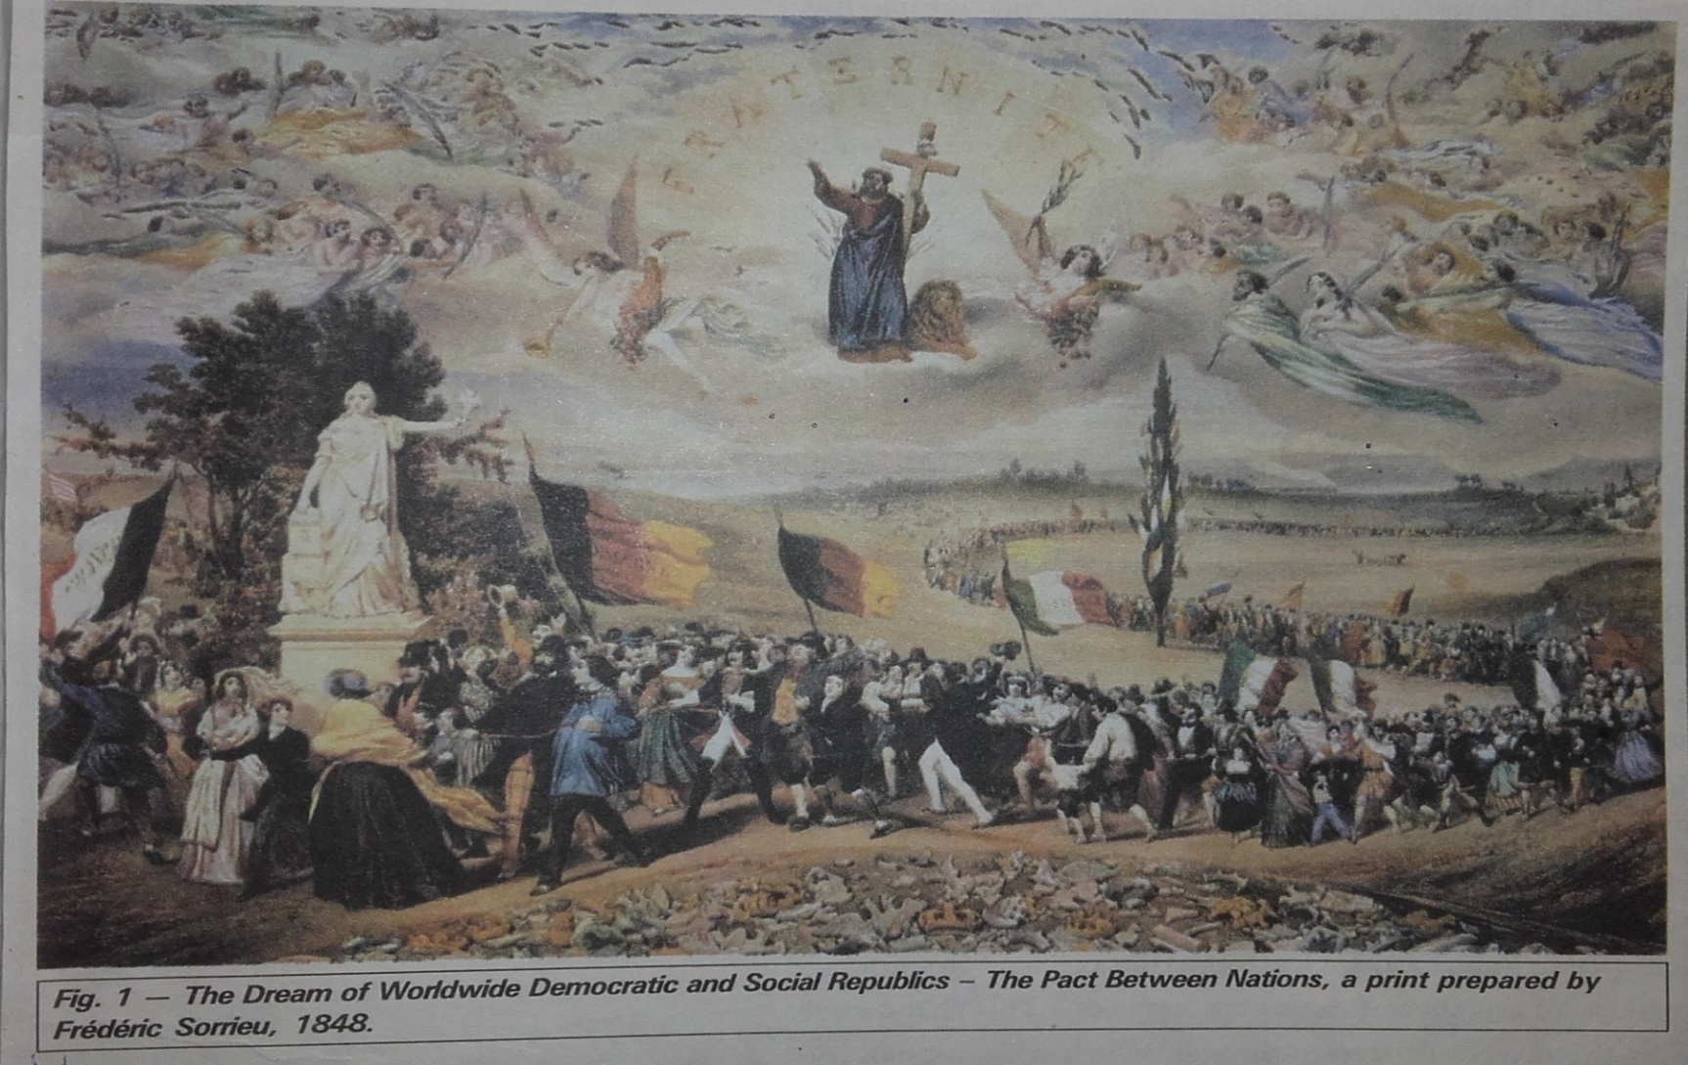
BRAIN STORMING

Slide 4
Picture Analysis
Name the title of the Print.
Name the Artist & his Nationality.
What was the vision of the Artist?
In what way this print depicts a utopian vision?

Slide 5
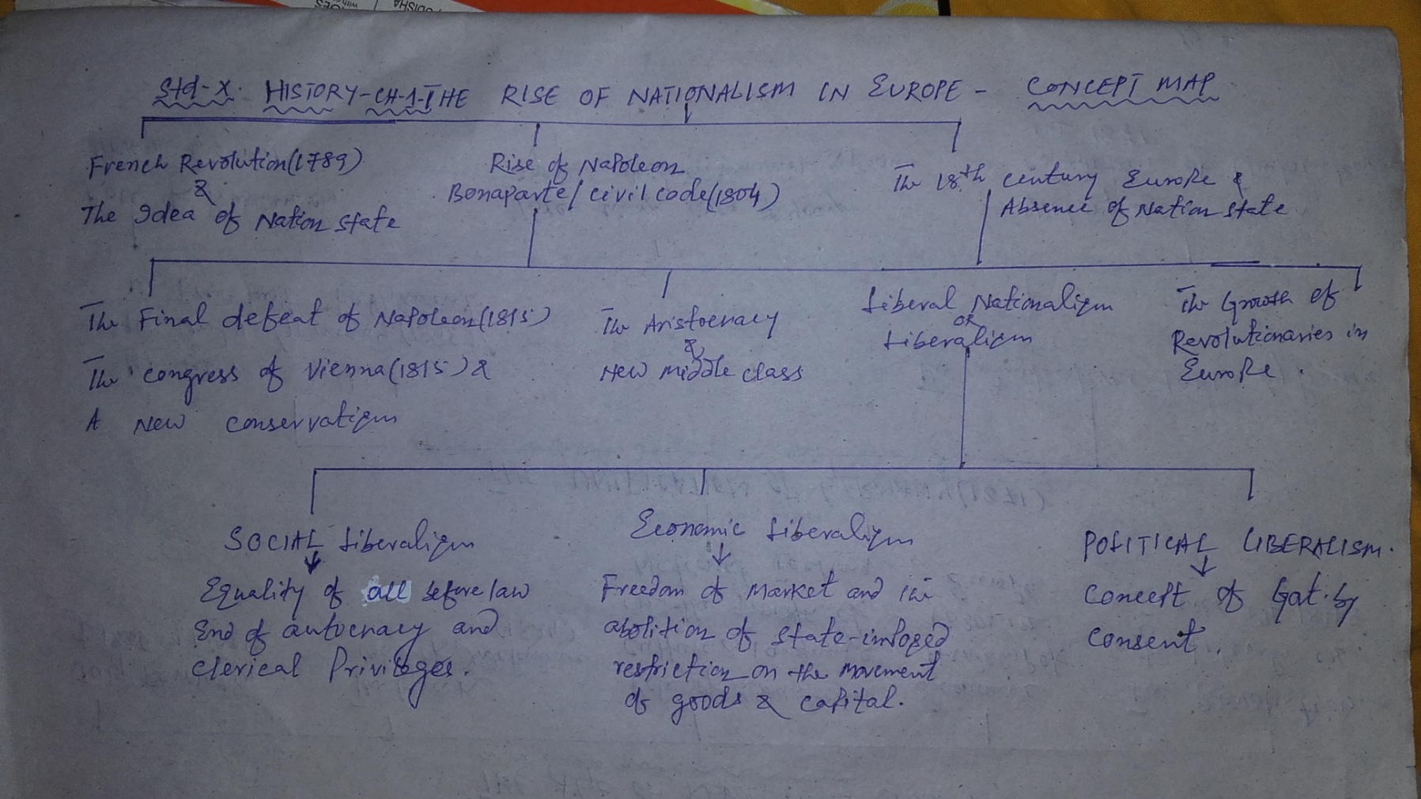
WHAT ARE WE GOING TO STUDY IN THIS CHAPTER -C0NCEPT MAP

Slide 6
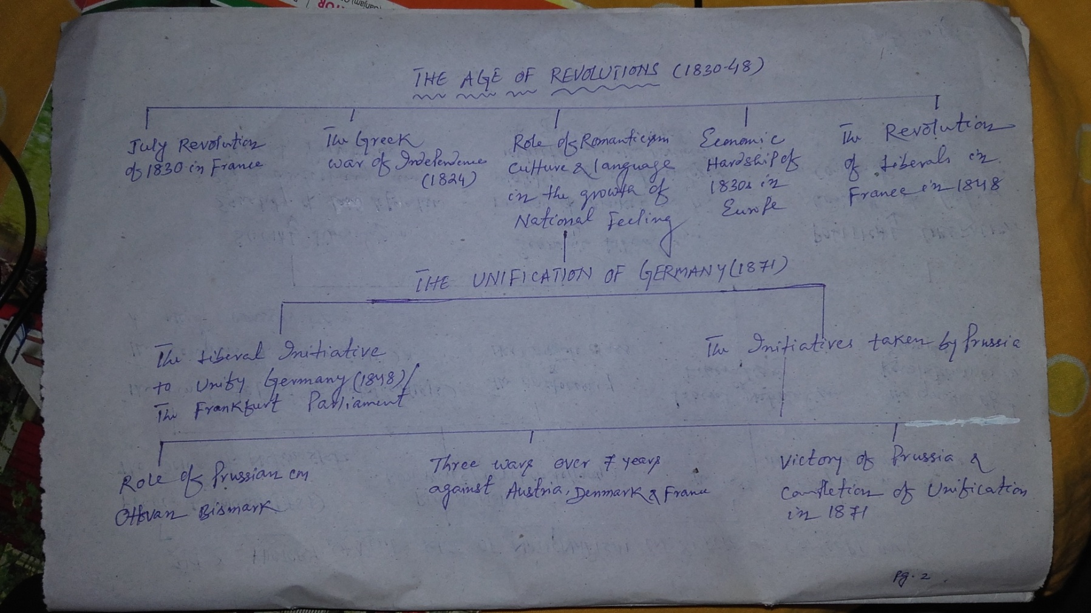
CONCEPT MAP - 2

Slide 7
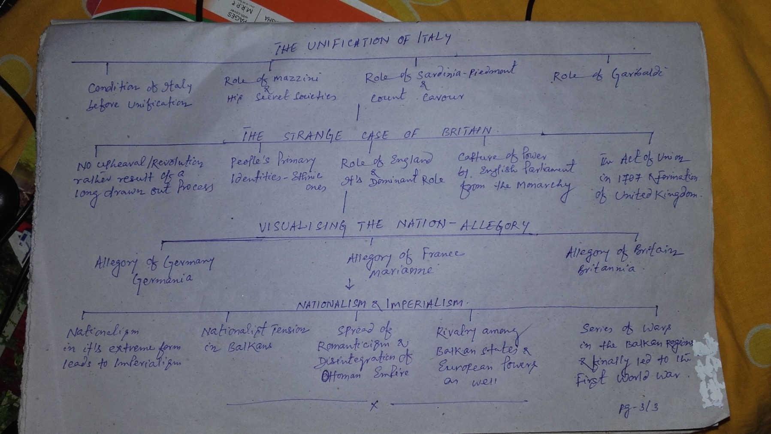
CONCEPT MAP - 3

Slide 8
EXPLANATION OF IMPORTANT TERMS
Nationalism - Patriotism (Love for one’s own Nation) , a sense of belongingness towards one’s own country
Nation –State – A modern-state(Country), having a centralized power exercised sovereign control over a clearly defined territory. Majority of it’s citizens and rulers have common identity & shared history or decent.

Slide 9
HOME WORK – DAY 1
Explain the following :
Absolutist.
Utopian Vision
Plebiscite &
Characteristics of a Nation-State

Slide 10
The French Revolution & the Idea of the Nation
French Revolution- 1789 : Transfer of Sovereignty from the Monarchy to a body of French Citizens.
Measures taken by the French Revolutionaries to create a sense of collective identity along the French people – La Patrie & Le Citoyen, New French Flag-the Tri Color in place of the Royal standard, Centralized Administrative system & French as spoken in Paris as common language

Slide 11
The Napoleonic Code (1804)
What is it?
Administrative Reforms taken by Napoleon Bonaparte otherwise known as Civil Code of 1804.
Features : Abolished privileges based on Birth, Established equality before the law, secured the right to property, simplified administrative divisions, abolished feudal system, freed peasants from serfdom and manorial dues, removed guild restrictions in towns, transport and communication system were improved, introduced uniform laws, standardized weights and measures and a common national currency.

Slide 12
CONDITIONOF EUROPE IN MID-18th CENTURY
No Nation –States like today.
Germany, Italy & Switzerland were divided into kingdoms, duchies and cantons
Habsburg Empire –Ruled over Austria-Hungary Ottoman Empire- Turkey were patch work of different region & people.
The Aristocracy – The dominating class
The Middle Class – Newly emerged & wanted change

Slide 13
HOME WORK – DAY 2
What steps did the French revolutionaries take to create a sense of collective identity among the French people?
What is Napoleonic Code? Write it’s features.
In spite of his Reform measures what led to the downfall of Napoleon Bonaparte?
Mid-18th century Europe had no Nation-State. Justify.
Who constitute the Middle Class in 18th century Europe?

Slide 14
LIBERAL NATIONALISM
Origin – Latin root- Liber meaning free.
Three Dimensions– Social, Political & Economic
Social Liberalism- Freedom for the individual and end of autocracy and clerical privileges.
Political Liberalism- Equality of all before the law & Concept of Govt. by consent
Economic Liberalism- Freedom of markets and abolition of state-imposed restrictions on the movement of goods and capital
It’s Need- Each region of Europe at that time had their own currency, weights & measures, custom barriers which were viewed as obstacles to economic exchange and growth.

Slide 15
A New Conservatism after 1815
Conservatism-A Pol. Philosophy that stressed the importance of tradition, established institutions & customs and preferred gradual development to quick change.
The Vienna Congress-1815 : Hosted by Austrian Chancellor Duke Metternich Attended by Britain, Russia, Prussia Objective-To draw up a settlement for Europe.

Slide 16
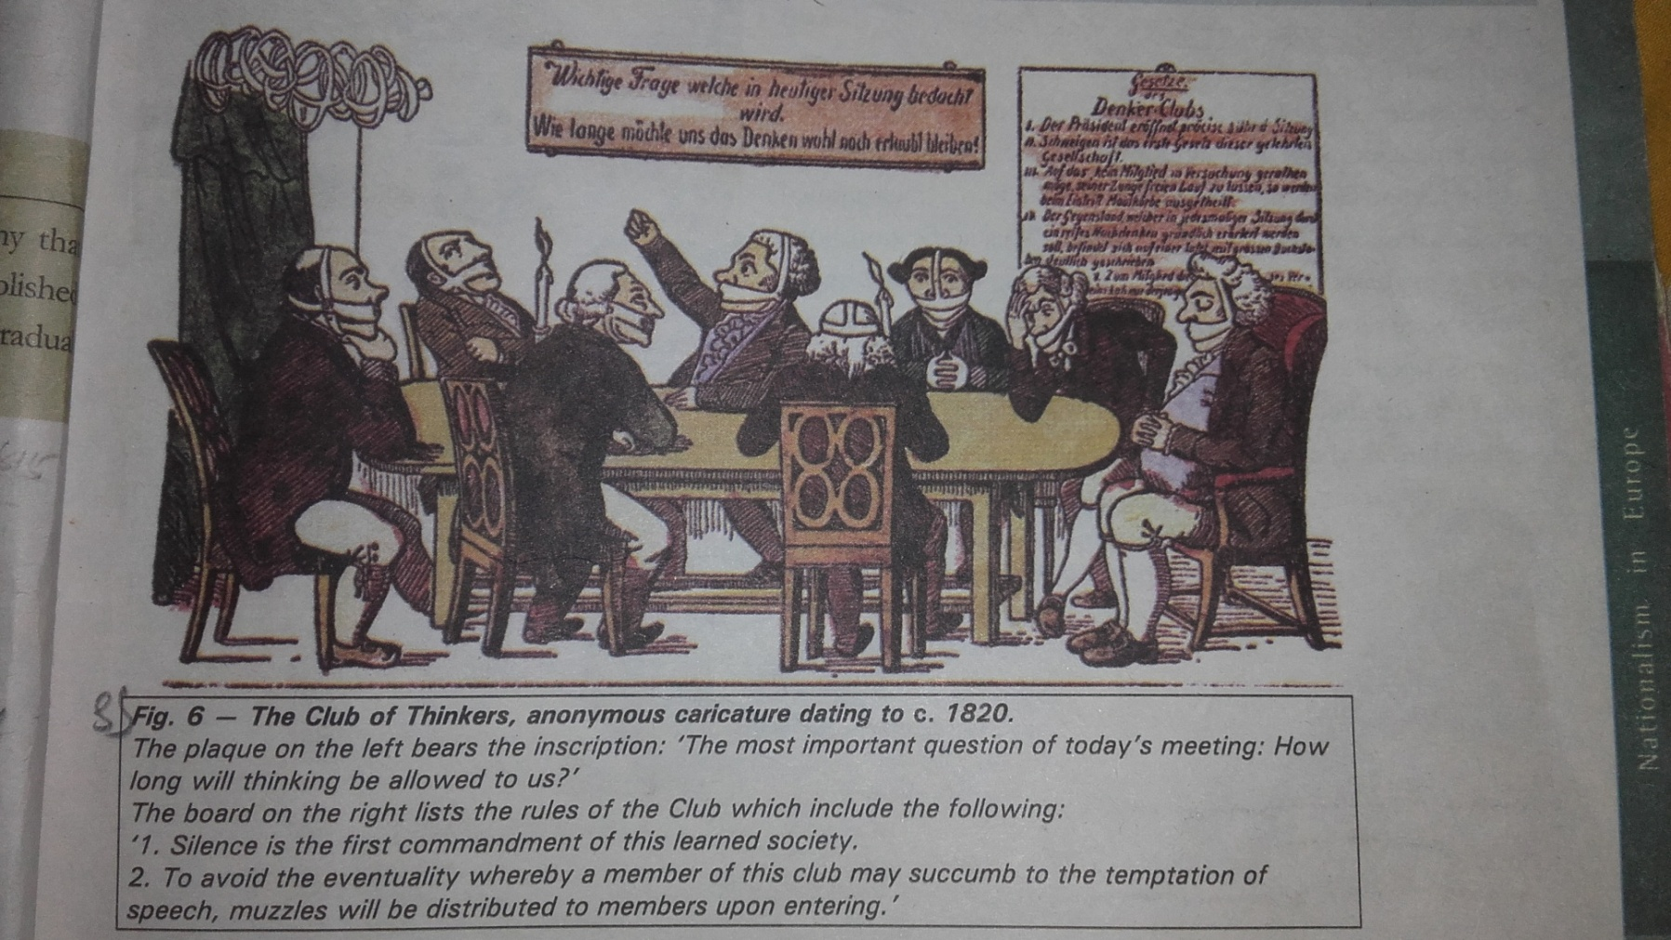
What is the caricaturist trying to depict?

Slide 17
HOME WORK – DAY 3
Define Liberalism. Explain its three aspects.
Explain the following : Suffrage, Elle, Zollverein, Conservatism
What was Congress of Vienna? What changes did it bring in Europe?
‘The Conservative regimes set up in 1815 were autocratic’. Justify.

Slide 18
The Revolutionaries in Europe
Establishment of Conservative Regimes after 1815 and repression of liberal nationalists in Europe.
Formation of Secret Societies and rise of Revolutionaries in Europe
Giuseppe Mazzini and his Secret Societies
‘Young Italy’ – In Marseilles & ‘Young Europe’ –In Berne. Their Role in the Unification of Italy

Slide 19
The Age of Revolutions: 1830-1834
The July Revolution of 1830 in France- Overthrown of the Bourbon Kings restored to power after 1815 & installation of a constitutional Monarchy – Head Louis Philippe
Uprising in Brussels- Belgium breaking away from the United Kingdom of Netherlands
Greek War of Independence-Began in1821 Greece – A part of Ottoman Empire since 15th century, Impact of revolutionary nationalism in Europe, Treaty of Constantinople -1822 recognized Greece as an independent nation.

Slide 20
Romantic Imagination & National Feeling
Role of Romanticism as a cultural movement
Role of Culture in creating the idea of the Nation i.e. art, poetry, stories and music
Role of Common People, folk song, folk poetry & folk dance as a part of German Culture for example
Role of vernacular language as in case of Poland

Slide 21
Hunger, Hardship & Popular Revolt
Economic Hardship in Europe in 1830s – Causes & Consequences
Silesian weavers’ Uprising -1845
Revolution of Liberals in France -1848 –Louis Philippe fled and France became a Republic
The Revolution of Liberals in German regions- 1848. The Frankfurt Parliament & causes of its failure.

Slide 22
HOME WORK – Day 4
Who was Giuseppe Mazzini?
Who described Mazzini as ‘the most dangerous enemy of Europe’s social order’ & Why?
Briefly describe the event that mobilized nationalist feelings among the educated elite across Europe
“The 1830s were years of great economic hardship in Europe “ Justify.
Give a brief description on Frankfurt Parliament .

Slide 23
The Unification of Germany(1871)
Liberal Initiative to unify Germany in 1848-Failed
Role of Prussia & Its CM Otto van Bismarck
Three Wars over 7 years against Austria, Denmark & France
Victory of Prussia & completion of unification in 1871 and proclamation of Kaiser William I of Prussia as emperor of United Germany

Slide 24
The Unification of Italy (1861)
Condition of Italy before Unification-Political fragmentation & scattered over several dynastic states
Role of Giuseppe Mazzini & his Secret Societies
Leadership of Sardinia-Piedmont-King Victor Emmanuel II & his CM Count Cavour
Policy of Tactful Diplomacy of Count Cavour
Role of Giuseppe Garibaldi

Slide 25
HOME WORK – Day 5
Briefly trace the process of German Unification.
Who was Ottoman Bismarck? What kind of policy followed by him for the Unification of Germany?
Briefly trace the process of Unification of Italy.
Write the role of Count Cavour in the process of Unification of Italy

Slide 26
Visualizing the Nation (Allegory)
Allegory-Personification of an abstract concept/Idea e.g. Liberty, Justice, Nation etc.
Allegory of Germany – Germania Characteristics – Crown of Oak leaves, Broken chain, Sword, Olive Branch around the sword, Breast plate with eagle, Black, Red & Golden Tri color Flag
Allegory of France – Marianne- Characteristics-The Red Cap, the Tri color & the cockade
Allegory of Britain- Britannia

Slide 27
HOME WORK – Day 6
How was the history of nationalism in Britain unlike the rest of Europe ?
Define Allegory?
Who were Germania & Marianne?

Slide 28
Nationalism & Imperialism
Nationalism in its extreme form led to Imperialism ( The practice of extending power, control & rule by a stronger country over a weaker one.
Nationalist tension in Balkans – Causes
Spread of Romantic Nationalism & disintegration of Ottoman Empire
Rivalry of Balkan States & European Powers as well led the world to World War I

Slide 29
HOME WORK – Day 7
Name the territories that comprise of Balkans.
What do you mean by Imperialism? How did Nationalism led to imperialism?
Why did nationalist tensions emerge in the Balkans?
……..

